Slide 1

32555 – Fundamentals of Software Development

Slide 2
Welcome to 32555 – Fundamentals of Software Development
Your Teaching Team:
Dr. Yining Hu | Subject Coordinator
Yining is a Lecturer in Software Engineering. She works with many SMEs to develop software and AI solutions through student and research projects at UTS.
Contact: yining.hu@uts.edu.au
Dr. Xiaojie (Zoe) Lin | Tutor
Zoe is a full-stack software engineer with an interest in data analysis, specializing in JAVA, R, Python, JavaScript, PHP, Bash, and MATLAB; familiar with AWS.
Contact: Xiaojie.Lin@uts.edu.au
Dr. Farshid Keivanian | Tutor
Dr. Farshid Keivanian is an experienced university lecturer and researcher with a PhD in Information Technology. He has over 15 years of teaching experience across Australian institutions, specialising in software engineering, data science, AI, and cybersecurity.
Contact: Farshid.Keivanian@uts.edu.au
Yong Pov | Tutor
Yong is a full-stack software engineer with experience in React, JavaScript, TypeScript, Java, Python, SQL, and AI-assisted learning platforms.
Contact: Yong.Pov@uts.edu.au

Slide 3
Welcome to 32555 – Fundamentals of Software Development
Cmp1 # | Location | Time | Tutor
01 | CB11.B1.400 | Fri 16:00-18:00 | Xiaojie (Zoe) Lin
07 | CB11.B1.401 | Wed 10:00-12:00 | Farshid Keivanian
08 | CB11.B1.400 | Fri 12:00-14:00 | Yong Pov
09 | CB11.B1.103 | Wed 16:00-18:00 | Farshid Keivanian
10 | CB11.B1.401 | Wed 12:00-14:00 | Farshid Keivanian

Slide 4
Welcome to 32555 Fundamentals of Software Development.
During this subject you will learn how software is:
Analysed
Designed
Developed
Tested
using
Java
Python
UML (UML = Unified Modeling Language)
By the end of the semester you will be able to build a small software system from beginning to end.

Slide 5
Welcome to 32555 Fundamentals of Software Development.
UML is a standard visual language used to plan and design software before writing code.
Example
Instead of writing code immediately,
we first draw diagrams showing
users
classes
relationships
system behaviour
This helps developers understand the software before implementation.

Slide 6
What will we learn?
This subject covers the complete software development process.
Topics include:
Software Development Process
Requirements Analysis
UML Modelling
Object-Oriented Programming
Java Programming
Python Programming
GUI Development
File Handling
Software Testing

Slide 7
Subject Learning Outcomes
By the end of this subject you should be able to:
Analyse software requirements
Design software using UML
Develop software using Java or Python
Test software
Build software that satisfies user requirements

Slide 8
Subject Structure
Weeks 1-2: from user requirements to design
Weeks 3-9: from design to software – CLI software development in iterations
Weeks 10-11: GUI implementation

Slide 9
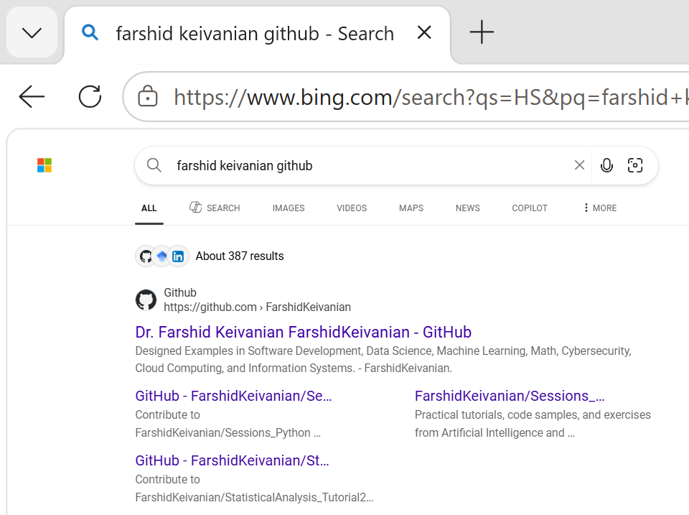
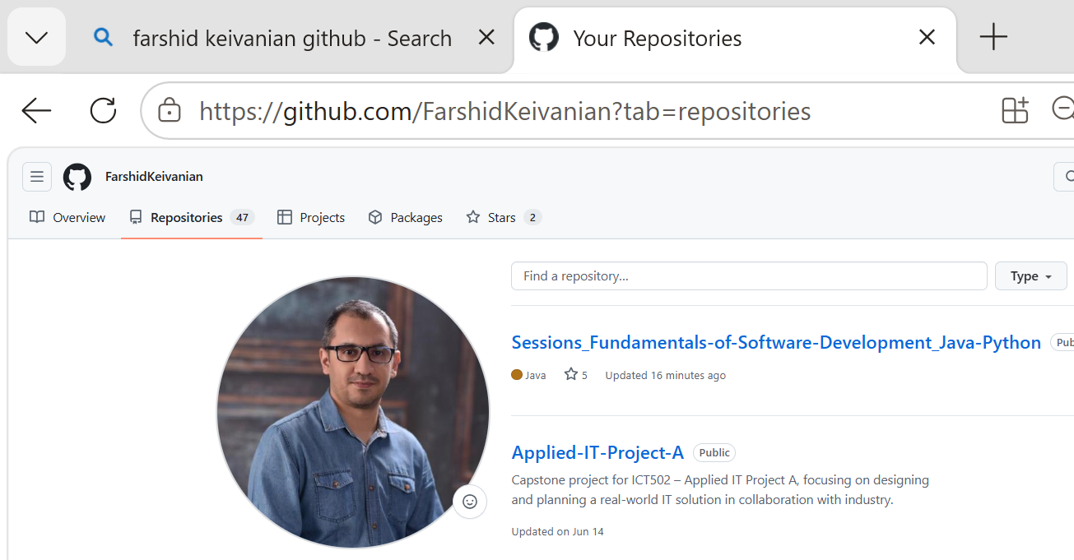
Weekly Learning Style
Google >> Farshid Keivanian GitHub
Repository >> Sessions_Fundamentals-of-Software-Development_Java-Python
It includes:
Weekly examples
Java examples
Python examples
OOP examples
Practice programs
Additional code discussed in class
I will continue uploading new materials every week.
Please check the repository regularly.

Slide 10
Weekly Learning Style
Before class
Read slides
During workshop
Mini lecture
Live coding
UML examples
Practice activities
Questions and discussion
After class
Practice programming
Review slides
Complete exercises

Slide 11
Assessment Overview
Assessment | Weight
Assessment 1 – Case Study | 70%
Quiz 1 | 15%
Quiz 2 | 15%

Slide 12
Assessment Overview
Quiz 1 (15)
Project (70):
Quiz 2 (15)
Week 7; in-class; content of Weeks 1-2
Week 12; in-class; content of Weeks 3-11
Part 1 (end of Week 7): requirement analysis (group, Sparkplus peer rating)
Part 2 (end of Week 13): software development (individual)
Part 3 (Week 12 & Week 13): Showcase
Notes:
For lecture demos, labs, assignments, quizzes – code in both java and python
Java -> demonstrates OOP
Python -> flexible, modern, easy to use
Subject offered to all students in MIT and MAI – some are advanced some are beginners
Show uts calendar

Slide 13
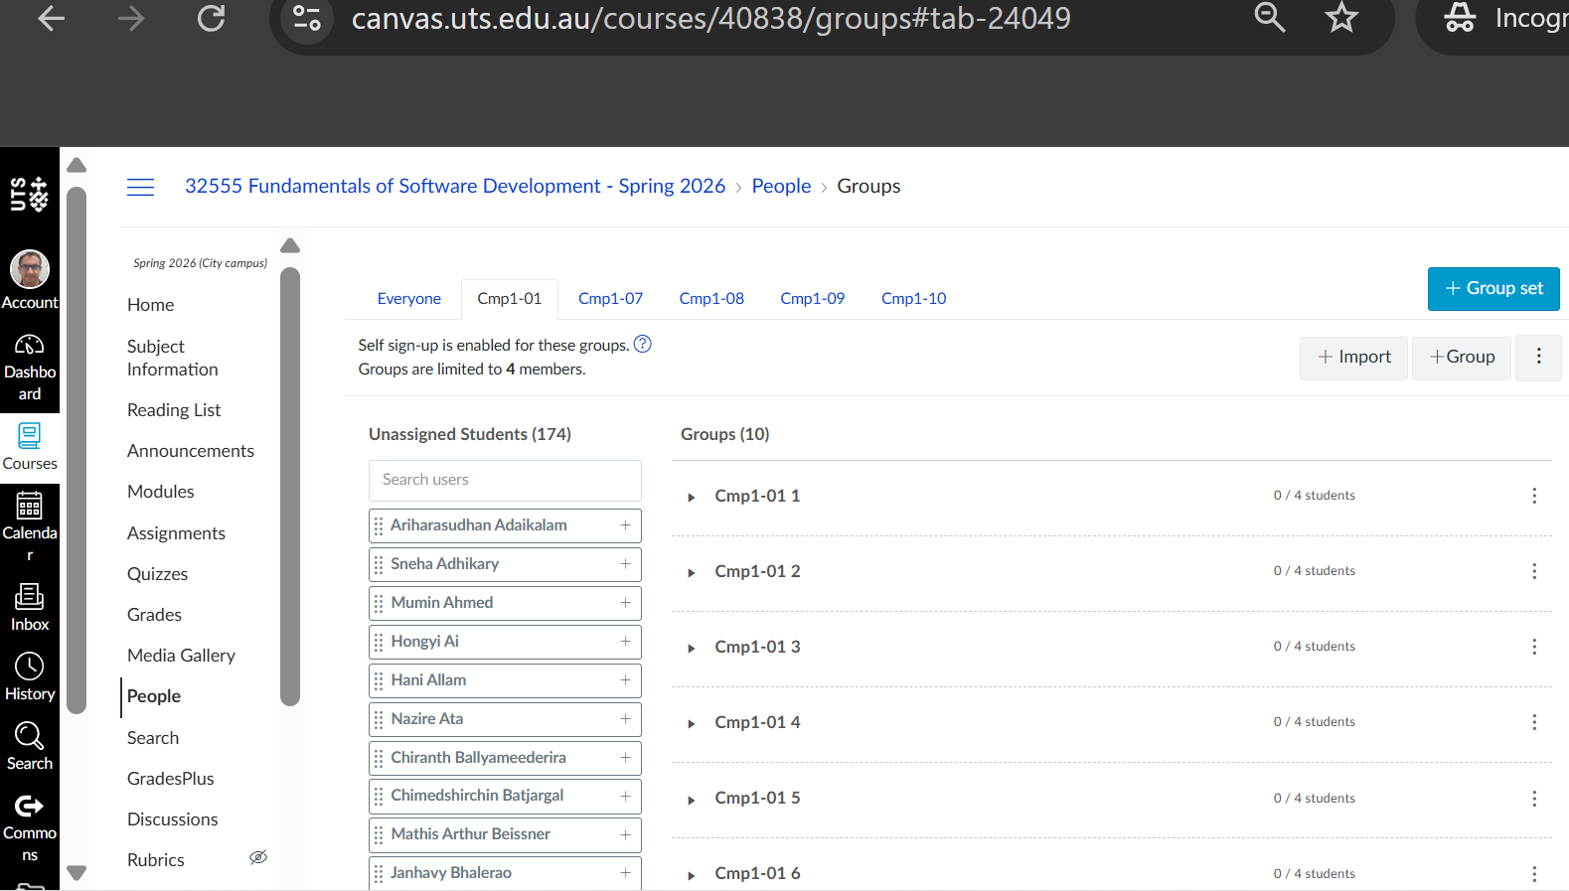
Assessment 1 (70%)
This is the major assessment.
It is completed in groups. Select your group in weeks 1 to 4
It contains three parts.
Part 1 (15%)
Analysis and Design
Week 7
Includes
Requirements
Use Cases
UML Use Case Diagram
UML Class Diagram

Slide 14
Assessment 1 (70%)
Part 2 (50%)
Software Development
Week 13
Develop the software using
Java OR Python
Implement
Classes
File handling
Exception handling
CLI (Command-Line Interface)
GUI (Graphical User Interface)

Slide 15
Assessment 1 (70%)
CLI = Command-Line Interface
Simple explanation:
Users interact with software by typing commands.
Example
1. Add Student
2. Search Student
3. Exit
Enter your choice:
There are no buttons.
Everything is entered using the keyboard.

Slide 16
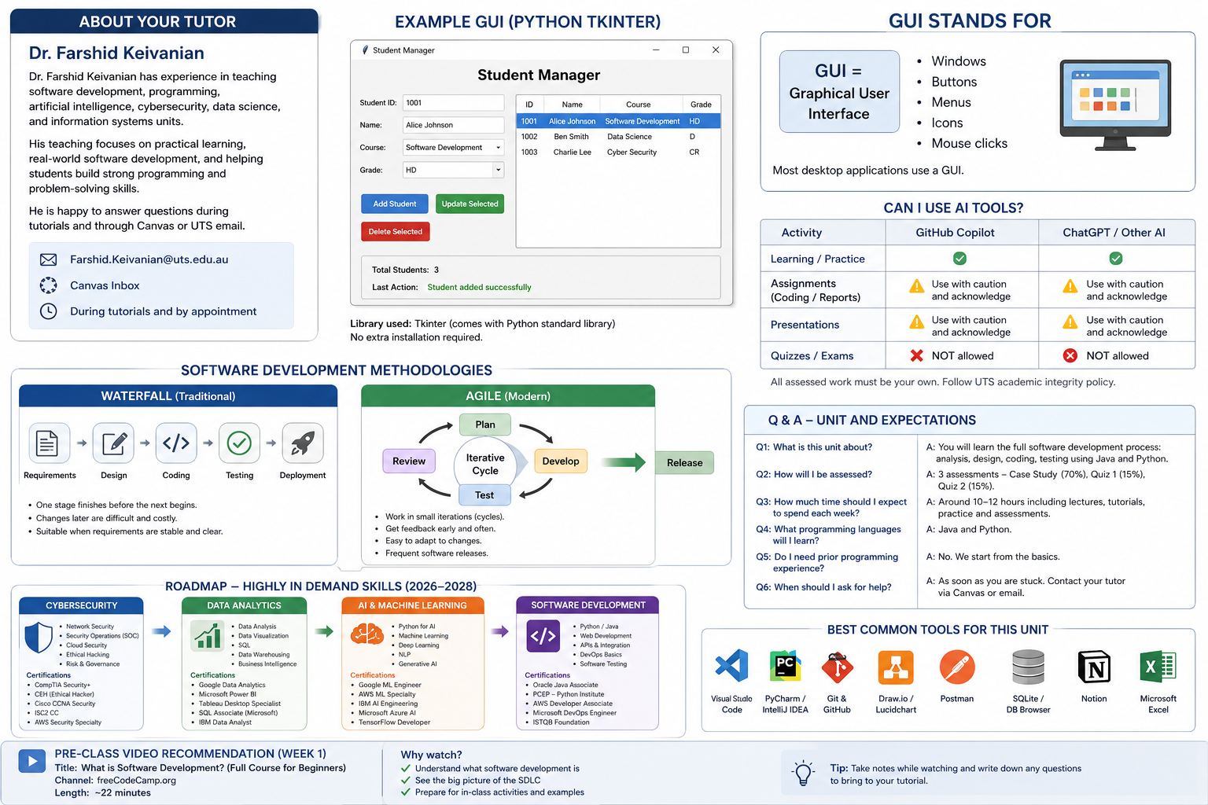
Assessment 1 (70%)
GUI = Graphical User Interface
Example
Windows
Buttons
Menus
Icons
Mouse clicks
Most desktop applications use a GUI.

Slide 17
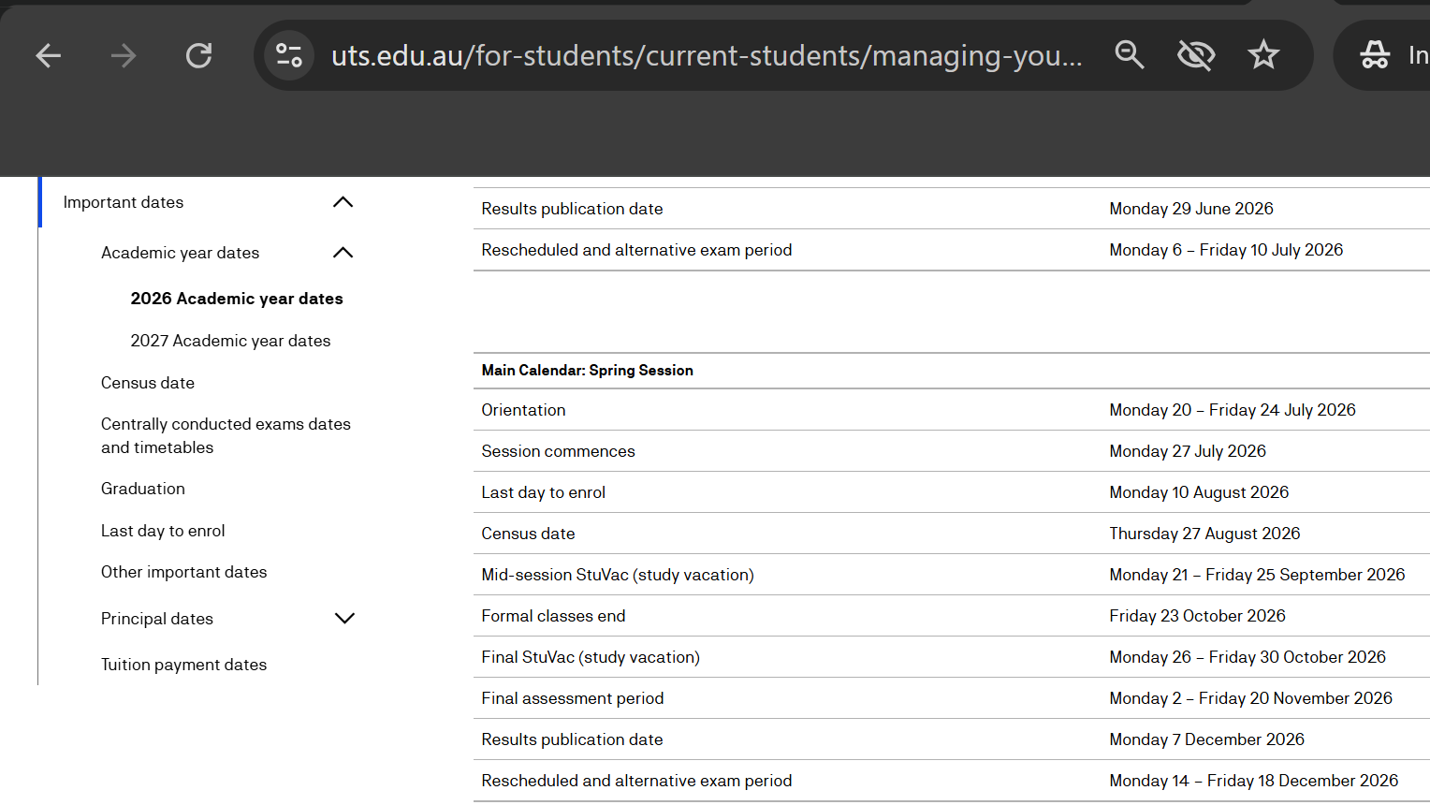
Assessment 1 (70%)
Part 3 (5%)
Project Showcase
Week 13 (19 to 23 Oct)
Each student demonstrates their software during lab.

Slide 18
Quiz 1 (15%)
Week 7
Individual
30 minutes
Single attempt
Restricted Open Book
Topics
Software Development
SDLC
Requirements
UML
Classes
Objects
Only subject materials may be used.
No Generative AI.
No collaboration.

Slide 19
Quiz 2 (15%)
Week 12
Individual
30 minutes
Topics
Programming
Java
or
Python
(depending on your stream)

Slide 20
Passing the Subject
To pass this subject
You must
achieve at least 50% overall
submit assessments before deadlines
maintain academic integrity

Slide 21
Academic Integrity
Your work must be your own.
You may
discuss ideas
ask questions
attend consultations
You may NOT
✖ copy another student's work
✖ use Generative AI during restricted quizzes
✖ submit someone else's code

Slide 22
Software Development Life Cycle (SDLC)
Software is usually developed step by step.
Example
Imagine we want to build a Library Management System.
1. Requirements
What does the customer need?
Example
Borrow books
Return books
Search books

Slide 23
Software Development Life Cycle (SDLC)
2. Analysis
Understand the problem.
Questions:
Who will use the system?
Students?
Librarians?
Administrators?

Slide 24
Software Development Life Cycle (SDLC)
3. Design
Plan the solution.
Draw
Use Case Diagram
Class Diagram

Slide 25
Software Development Life Cycle (SDLC)
4. Coding
Write the software in
Java or
Python

Slide 26
Software Development Life Cycle (SDLC)
5. Testing
Check whether everything works correctly.
Example
Does "Borrow Book" work?
Can invalid input be detected?

Slide 27
Software Development Life Cycle (SDLC)
6. Deployment
Install the software for users.
Example
Install it in the university library.
7. Maintenance
Fix bugs.
Add new features.
Example
Later the library requests:
"Please add online reservations."

Slide 28
Why do we need a Software Development Methodology?
Imagine building a house.
Would you start building before making a plan?
No.
Software is the same.
A methodology provides a structured way to build software successfully.

Slide 29
Software Development Methodologies
A methodology is how we organise the software development process.

Slide 30
Object-Oriented Programming
This subject focuses on Object-Oriented Programming (OOP).
Main concepts
Classes
Objects
Encapsulation
Inheritance
Polymorphism
Abstraction
We will learn these step-by-step.

Slide 31
Software Development Tools
During this semester we will use
Python
Java
VS Code / IDE
UML tools
Canvas
GitHub

Slide 32
Software Development Tools
What is Postman used for?
Postman is a tool for testing APIs (Application Programming Interfaces).
Suppose a program provides weather information.
Instead of opening a website, Postman can send a request directly to the server.
Example:
GET
https://api.weather.com/current
The server replies:
{
"temperature":22,
"city":"Sydney"
}

Slide 33
Software Development Tools
What is Notion?
Notion is an all-in-one workspace used to organise information, notes, projects, and team collaboration.
Think of it as a combination of:
Microsoft Word
OneNote
Trello
Planner
Wiki
all in one application.

Slide 34
Software Development Tools
Students do not need to use for this unit. What can students use Notion for?
Organising lecture notes
Managing assessment deadlines
Planning a group project
Recording meeting notes
Creating a personal study planner
Tracking weekly progress
Writing project documentation

Slide 35
Software Development Tools
Why do software developers use Postman?
Postman allows developers to:
Test REST APIs
Send GET requests
Send POST requests
Update data (PUT/PATCH)
Delete data (DELETE)
View JSON responses
Test authentication (API keys, tokens)
Debug backend services

Slide 36
Software Development Tools
Will students use Postman in this unit?
Based on the subject outline, no.
This subject focuses on:
Software development
UML
Java
Python
CLI
GUI
Testing
No need to build or test web APIs.

Slide 37
Software Development Tools
For this unit, I would recommend:
Required
Canvas
Python 3
Java JDK
VS Code or IntelliJ IDEA
GitHub (recommended for group work)
diagrams.net (Draw.io) for UML

Slide 38
Software Development Tools
Useful
GitHub Desktop
Notepad++
Microsoft Office
Later (for further development)
JavaFX
Tkinter
JUnit
Maven
This list is more closely aligned with the learning outcomes and assessment tasks for the subject.

Slide 39
Software Development Tools
GitHub Desktop (Recommended for Beginners)
Many first-year and postgraduate students prefer GitHub Desktop because they don't need to remember Git commands.
The typical workflow is:
Clone the repository (first time only).
Open the project and make changes.
GitHub Desktop automatically shows the changed files.
Enter a short commit message, such as "Added login feature".
Click Commit to main.
Click Push origin to upload the changes to GitHub.
Students can complete most common Git tasks using the graphical interface without using the command line.

Slide 40
Roadmap – Highly In Demand Skills (2026 – 2028)

Slide 41
Can I use AI Tools?

Slide 42
Should we use GitHub for the group project?
Yes, I strongly recommend it.
GitHub helps your team:
Store your project safely online.
Work together without overwriting each other's code.
Keep a history of changes.
Restore previous versions if something goes wrong.
Demonstrate your contribution to the project.
Many software companies use GitHub every day.
Note: GitHub is recommended for collaboration. Always follow the assessment instructions provided by the Subject Coordinator.

Slide 43
Should we use GitHub for the group project?
Each student:
writes code
commits changes
pushes to GitHub
Everyone can then pull the latest version.

Slide 44
Git vs GitHub
Students often confuse these.
Git is the version control tool. GitHub is the online service that stores Git projects and allows teams to collaborate.
Git | GitHub
Software installed on your computer | Website for hosting Git repositories
Tracks code changes | Stores projects online
Used with the command line or IDE | Used for collaboration
Works offline | Requires internet for syncing

Slide 45
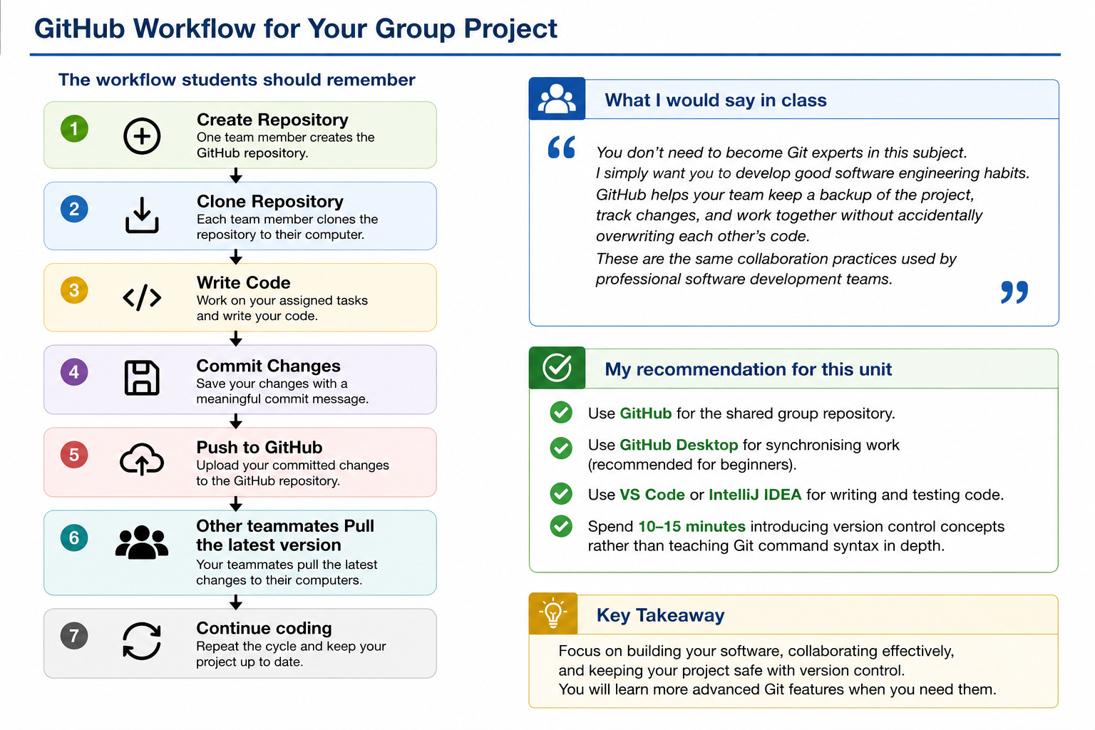
GitHub workflow for a Group Project

Slide 46
My recommendation

Slide 47
Python Installation
Please install the latest version of Python.
Also install
VS Code (or another IDE)
Tkinter support
Installation guides are available on Canvas.
If you experience any problems, let me know during the workshop.

Slide 48
Communication
If you have questions,
please contact me through
Discussion Forums
Canvas Inbox
UTS Email (Farshid.Keivanian@uts.edu.au)
I regularly monitor my emails and will reply as soon as possible.

Slide 49
Week 7 Reminder (include around Week 7)
Quiz 1
Assessment Task 2
Worth 15%
During your scheduled lab
30 minutes
Single attempt
Restricted Open Book
Remember:
Use the lab computer only.
You may refer to subject materials only.
Do not use Generative AI.
Do not collaborate with other students.
For code questions, read and analyse the code without running it.

Slide 50
Week 1 Practice Quiz
Question 1
Week 1 Practice Quiz: Question 1
Which of the following best describes a software development methodology?
A. Software methodology is a way to test functions.
B. Software methodology is the process used to create programs.
C. Software methodology is only used in procedural programming.
D. Software methodology is only used for object-oriented programming.

Slide 51
Week 1 Practice Quiz
Correct answer: B
Software methodology is the process used to create programs.
A software development methodology provides a structured approach for:
Planning
Analysing
Designing
Coding
Testing
Deploying
Maintaining software

Slide 52
Week 1 Practice Quiz
Examples include Waterfall and Agile.
Why are the other options incorrect?
A. Incorrect: Testing functions is only one part of software development.
C. Incorrect: Methodologies are not limited to procedural programming.
D. Incorrect: Methodologies are not limited to object-oriented programming.

Slide 53
Week 1 Practice Quiz
Question 2
Which of the following is not a characteristic of Agile?
A. At the end of every Agile cycle, a new version of the software is released.
B. Agile repeats Software Development Life Cycle steps.
C. Agile completes the Software Development Life Cycle in sequential order with fixed project requirements.
D. Agile allows new requirements after a prototype has been released.

Slide 54
Week 1 Practice Quiz
Select the option that does not describe Agile.
Correct answer: C
Agile completes the Software Development Life Cycle in sequential order with fixed project requirements.
This statement describes the Waterfall methodology, not Agile.
Explanation of the options
A. Agile characteristic: Each cycle may produce a new or improved version of the software.
B. Agile characteristic: Planning, development, and testing are repeated during multiple cycles.

Slide 55
Week 1 Practice Quiz
C. Not an Agile characteristic: Agile does not require all stages to be completed once in a fixed sequence.
D. Agile characteristic: New or changed requirements can be considered during later cycles.
Simple example
A customer tests an early version of an online shopping system and asks for a wishlist feature. Agile allows the development team to add this request to a future cycle.

Slide 56
Week 1 Practice Quiz
Question 3
Week 1 Practice Quiz: Question 3
Which of the following is an imperative programming paradigm type?
A. Mathematical
B. Logical
C. Functional
D. Object-Oriented

Slide 57
Week 1 Practice Quiz
Which of the following is an imperative programming paradigm type ?
Mathematical
Logical
Functional
Object-Oriented

Slide 58
Week 1 Practice Quiz
Correct answer: D – Object-Oriented
Imperative programming describes a program as a sequence of instructions that changes the program’s state.
Object-oriented programming commonly uses this step-by-step approach through:
Objects
Methods
Variables
Assignment statements
Control structures
Java and Python both support object-oriented programming.

Slide 59
Week 1 Practice Quiz
Why are the other options incorrect?
A. Mathematical: This is not normally listed as a main programming paradigm.
B. Logical: Logic programming is a declarative paradigm. Prolog is an example.
C. Functional: Functional programming focuses on functions and expressions. Haskell is an example.

Slide 60
Week 1 Practice Quiz
Question 4
Which statement best describes procedural programming?
A. All system functions can access the same global variables.
B. Functions are encapsulated with the data.
C. C++ is a procedural programming language.
D. Procedural programming organises goals into classes.
Select the best answer from the options provided.

Slide 61
Week 1 Practice Quiz
Intended answer: A
All system functions can access the same global variables.
Traditional procedural programs may use shared global data that can be accessed by different procedures or functions.
Explanation of the options
A. Intended correct answer: Procedural programs may use functions that operate on shared data.
B. Incorrect: Combining data and related operations describes encapsulation in object-oriented programming.

Slide 62
Week 1 Practice Quiz
C. Not the best answer: C++ supports procedural programming, but it is a multi-paradigm language and also strongly supports object-oriented programming.
D. Incorrect: Classes are mainly associated with object-oriented programming.
Important clarification
A clearer definition of procedural programming is:
Procedural programming organises a program into procedures or functions that perform a sequence of instructions.
The use of global variables is possible, but it is not required in every procedural program.

Slide 63
Week 1 Practice Quiz
Question 5
Which statement is not correct?
A. Object-oriented programs are better designed.
B. Object-oriented operation definitions are hidden; only behaviour is exposed to other classes.
C. Object-oriented class data is available to all system functions.
D. An object-oriented program can create many objects from the same class.
Select the statement that is incorrect.

Slide 64
Week 1 Practice Quiz
Correct answer: C
Object-oriented class data is available to all system functions.
This statement is incorrect because object-oriented programming commonly uses encapsulation to control access to data.
Example
private double balance;
Because balance is private, other classes cannot access it directly.

Slide 65
Week 1 Practice Quiz
Explanation of the options
A. Generally correct: Object-oriented design can improve organisation, modularity, maintainability, and reuse.
B. Correct: Internal implementation details can be hidden while required behaviour is provided through public methods.
C. Incorrect: Class data should not automatically be available to every function in the system.
D. Correct: One class can be used to create many objects.
Example
Student student1 = new Student();
Student student2 = new Student();
Both objects are created from the same Student class.

Slide 66
Week 1 Practice Quiz
Question 6 –
Which statement best describes software requirements analysis?
A. Requirements analysis is a way to create software architecture.
B. Requirements analysis refines and transforms requirements into user stories.
C. Requirements analysis identifies classes and their attributes.
D. Requirements analysis is used to create software design.
Select the best answer.

Slide 67
Week 1 Practice Quiz
Correct answer: B
Requirements analysis refines and transforms requirements into user stories.
Requirements analysis helps the development team understand:
What users need
What the system must do
Who will use the system
What conditions or limitations apply

Slide 68
Week 1 Practice Quiz
Explanation of the options
A. Incorrect: Software architecture is normally developed during system design.
B. Correct: User needs may be refined and documented as requirements or user stories.
C. Incorrect: Identifying classes and attributes is usually part of object-oriented analysis and design.
D. Incorrect: Requirements analysis provides information for the design, but it is not the same as creating the design.
Example user story
As a library member, I want to search for a book so that I can check whether it is available.

Slide 69
Week 1 Practice Quiz
Question 7 –
Why is documentation testing necessary?
A. To have morning coffee with stakeholders.
B. To create the project development schedule.
C. To identify classes in the software.
D. To ensure the correctness of the requirements.
Select the best answer.

Slide 70
Week 1 Practice Quiz
Correct answer: D
Documentation testing is necessary to ensure the correctness of the requirements.
Reviewing requirements documentation helps identify:
Missing information
Contradictions
Unclear statements
Incorrect assumptions
Requirements that cannot be tested

Slide 71
Week 1 Practice Quiz
Explanation of the options
A. Incorrect: This is unrelated to documentation testing.
B. Incorrect: Creating a schedule is a project management activity.
C. Incorrect: Classes are normally identified during object-oriented analysis and design.
D. Correct: Reviewing documentation helps ensure that the requirements are clear and correct.

Slide 72
Week 1 Practice Quiz
Example
A requirement states:
The system must support online payments.
The development team should clarify:
Which payment methods?
Which currencies?
What happens if payment fails?
Is a receipt required?
It is easier to correct these issues before coding begins.

Slide 73
Week 1 Practice Quiz
Question 8 –
Which of the following is not a step in the requirements analysis process?
A. Create a class diagram.
B. Create a use-case diagram.
C. Map user stories to a table.
D. Convert requirements into user stories.
Select the activity that does not belong directly to requirements analysis.

Slide 74
Week 1 Practice Quiz
Question 8
Which of the following is not a step of the requirement analysis process ?
Group of answer choices
Create a class diagram
Create a use-case diagram
Map the user-stories to a table
Convert requirements to user-stories

Slide 75
Week 1 Practice Quiz
Correct answer: A
Create a class diagram.
A class diagram is mainly used during object-oriented analysis and system design to represent:
Classes
Attributes
Methods
Relationships between classes

Slide 76
Week 1 Practice Quiz
Explanation of the options
A. Correct answer: Creating a class diagram normally belongs to a later analysis or design activity.
B. Part of requirements analysis: A use-case diagram shows how actors interact with the system.
C. Part of requirements analysis: A table can help organise and trace user stories.
D. Part of requirements analysis: User needs can be converted into clear user stories.

Slide 77
Week 1 Practice Quiz
Question 9
Which of the following cannot be an actor in a use-case diagram?
A. Person
B. Cash register
C. Login
D. Printer
Select the option that is not an actor.

Slide 78
Week 1 Practice Quiz
Correct answer: C – Login
An actor is a person, organisation, external device, or external system that interacts with the software.
Login is an action or system function. It is therefore more suitable as a use case, not an actor.
Explanation of the options
A. Person: Can be an actor, such as a customer or administrator.
B. Cash register: Can be an external device or system interacting with another system.

Slide 79
Week 1 Practice Quiz
C. Login: This is an action performed by an actor.
D. Printer: Can be an external device interacting with the system.
Simple use-case example
Actor: Student Use case: Log in System: Student portal

Slide 80
Week 1 Practice Quiz
Question 10
A sequence diagram is an example of a:
A. Behaviour diagram
B. Interaction diagram
C. Structure diagram
Select the most specific answer.

Slide 81
Week 1 Practice Quiz
Correct answer: B – Interaction diagram
A sequence diagram shows:
Objects or participants
Messages exchanged between them
The order in which interactions occur
How the interaction changes over time

Slide 82
Week 1 Practice Quiz
Explanation of the options
A. Behaviour diagram: Sequence diagrams are broadly included within UML behaviour diagrams, but this is not the most specific answer.
B. Interaction diagram: This is the best and most specific classification.
C. Structure diagram: Structure diagrams show the static parts of a system. A class diagram is an example.

Slide 83
Week 1 Practice Quiz
Simple example
Customer → ATM: Insert card
ATM → Customer: Request PIN
Customer → ATM: Enter PIN
ATM → Bank System: Validate PIN
Bank System → ATM: PIN accepted
The sequence diagram shows the order in which these messages are exchanged.

Slide 84
Choosing Your Development Environment (IDE)
IDE | Java | Python | Recommended
VS Code |  |  | Recommended (supports both Java and Python)
IntelliJ IDEA Community |  | Limited (requires plugin) | Excellent for Java
Eclipse IDE |  | Possible with PyDev plugin | Good for Java
PyCharm Community | X |  | Excellent for Python

Slide 85
Choosing Your Development Environment (IDE)
You are welcome to use the IDE that you are most comfortable with, provided it supports the required programming language and you can successfully complete the assessment tasks.
If you are developing in Java, IntelliJ IDEA or Eclipse are both excellent choices.
If you are developing in Python, VS Code or PyCharm are recommended.
If you would like to use one IDE for both Java and Python, VS Code is probably the easiest option.

Slide 86
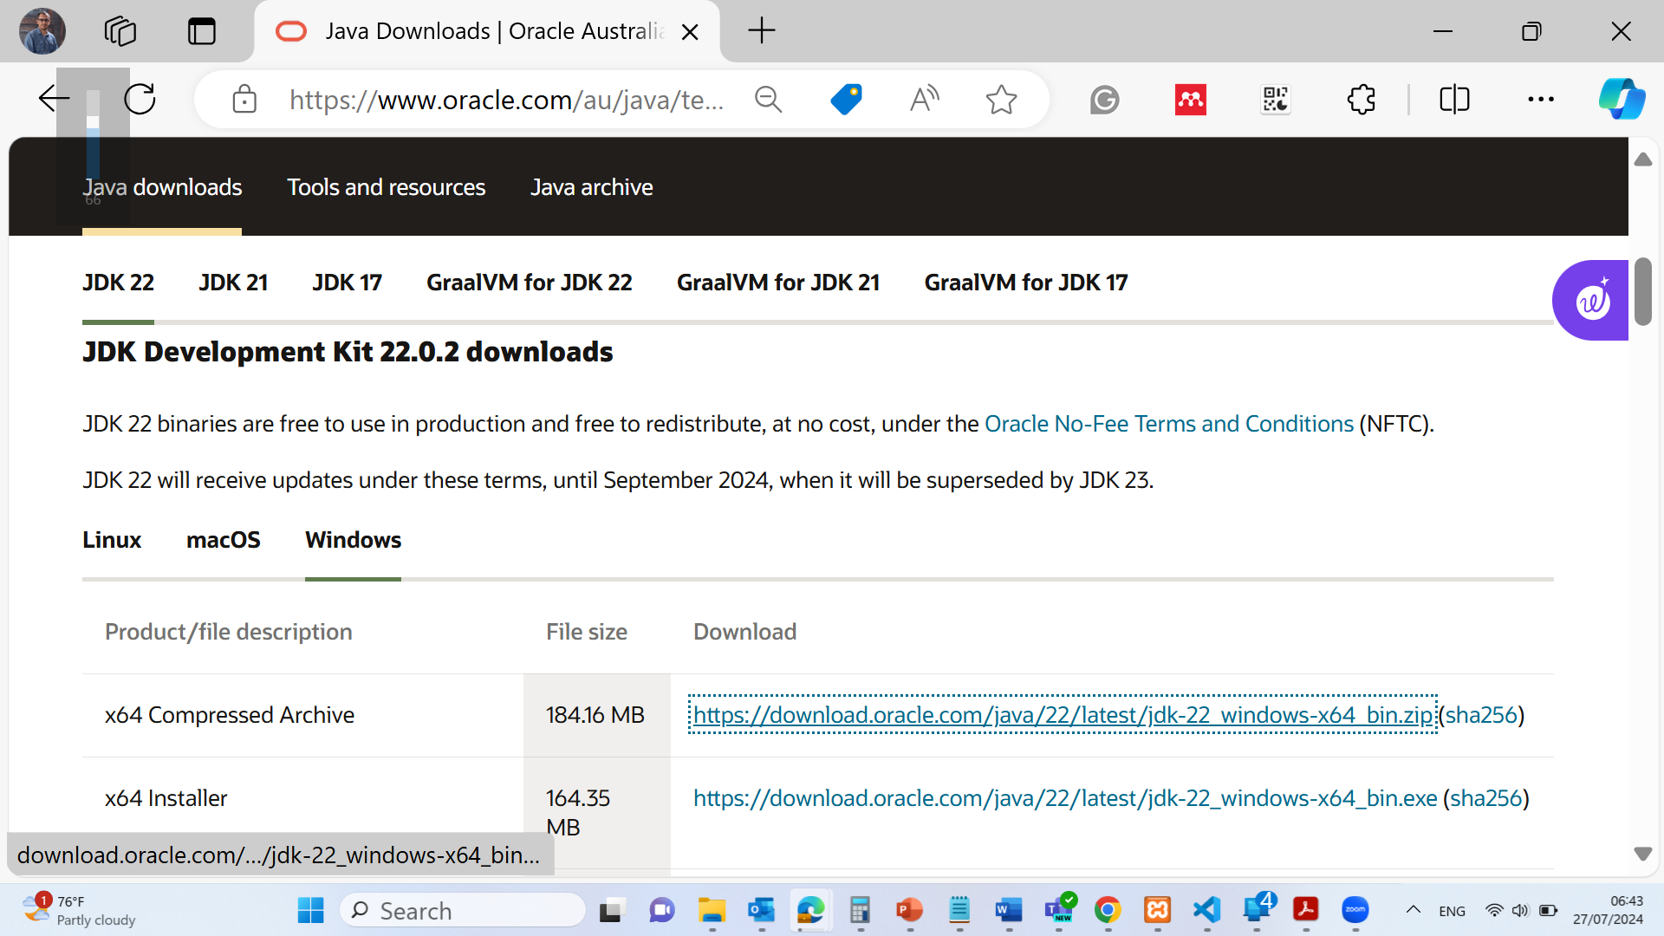
If you choose Eclipse IDE (Java)
Download and install the idk package https://www.oracle.com/au/java/technologies/downloads/#jdk22-windows

Slide 87
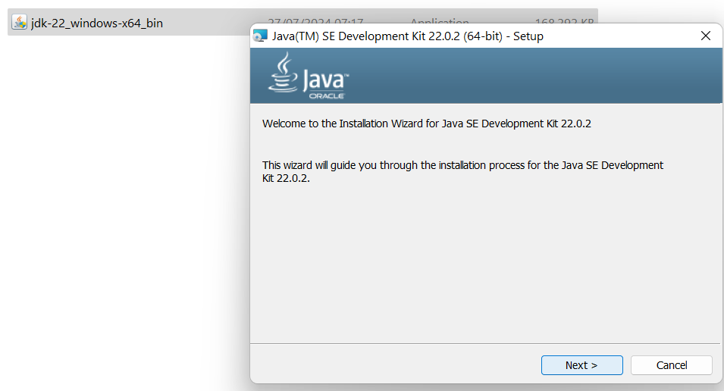
If you choose Eclipse IDE (Java)
Download and install the idk package https://www.oracle.com/au/java/technologies/downloads/#jdk22-windows

Slide 88
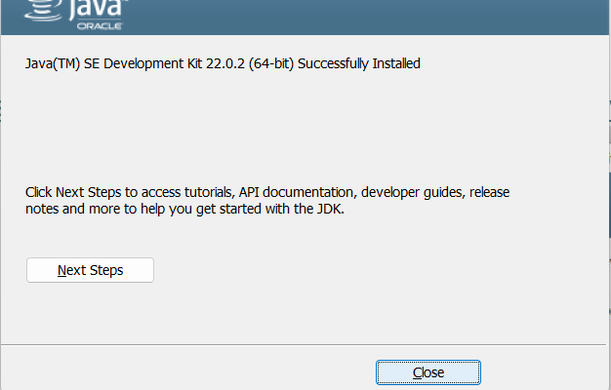
If you choose Eclipse IDE (Java)
Download and install the idk package https://www.oracle.com/au/java/technologies/downloads/#jdk22-windows

Slide 89
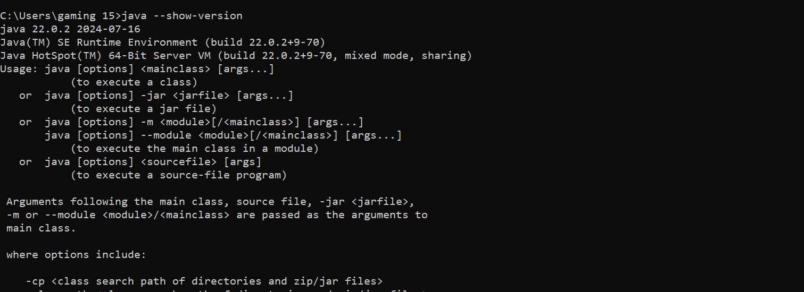
If you choose Eclipse IDE (Java)
Command Prompt Windows / Terminal in MAC: java –show-version

Slide 90
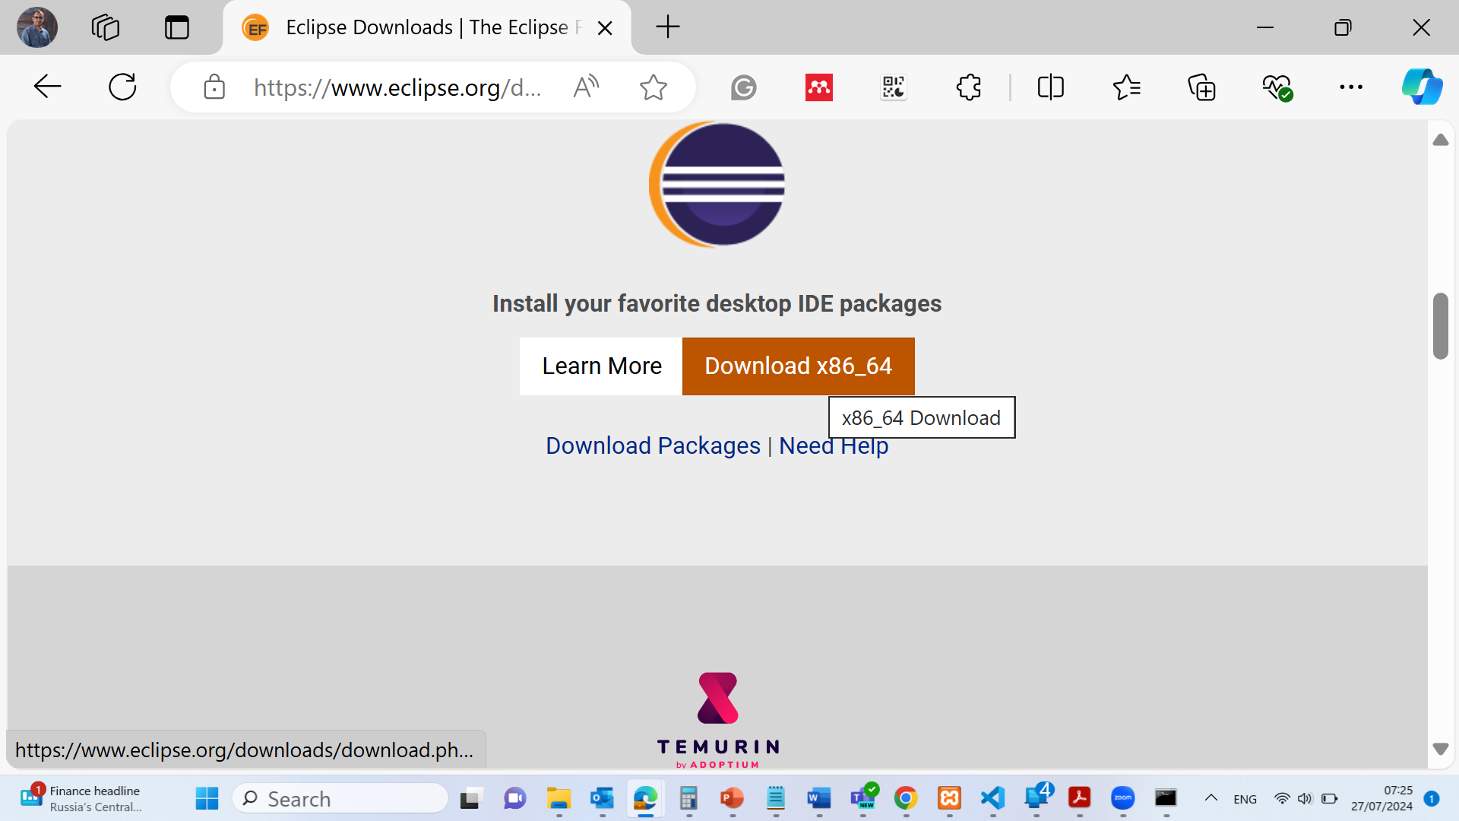
If you choose Eclipse IDE (Java)
Download Eclipse Software https://www.eclipse.org/downloads/

Slide 91
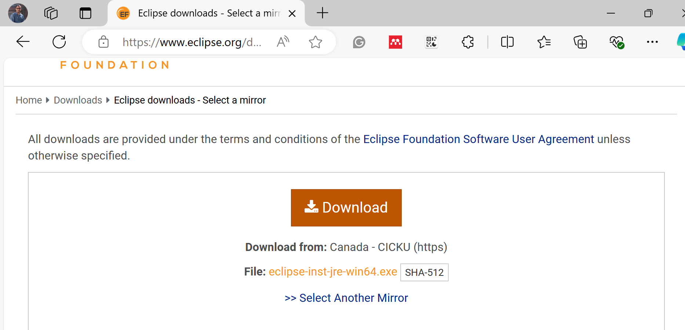
If you choose Eclipse IDE (Java)
Download Eclipse Software https://www.eclipse.org/downloads/

Slide 92
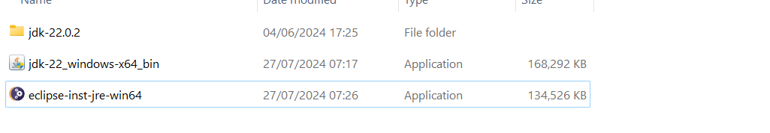
If you choose Eclipse IDE (Java)
Install Eclipse Software https://www.eclipse.org/downloads/

Slide 93
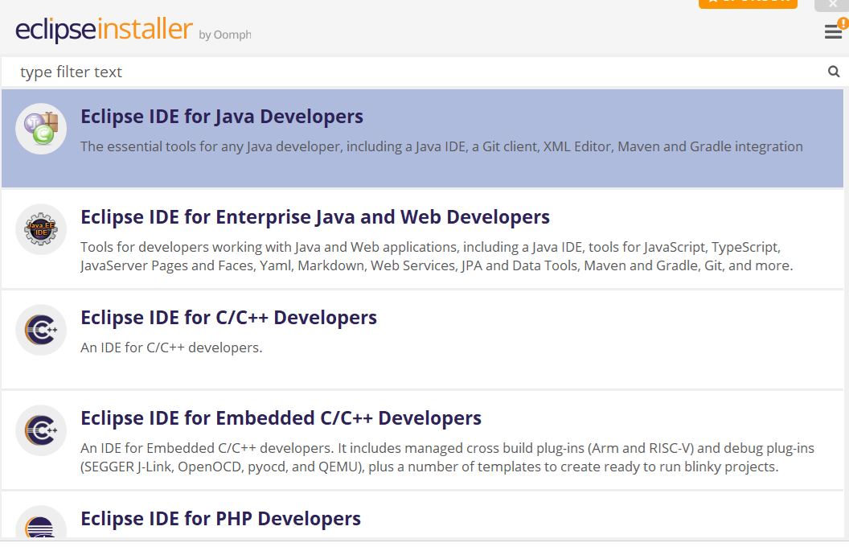
If you choose Eclipse IDE (Java)
Install Eclipse Software https://www.eclipse.org/downloads/

Slide 94
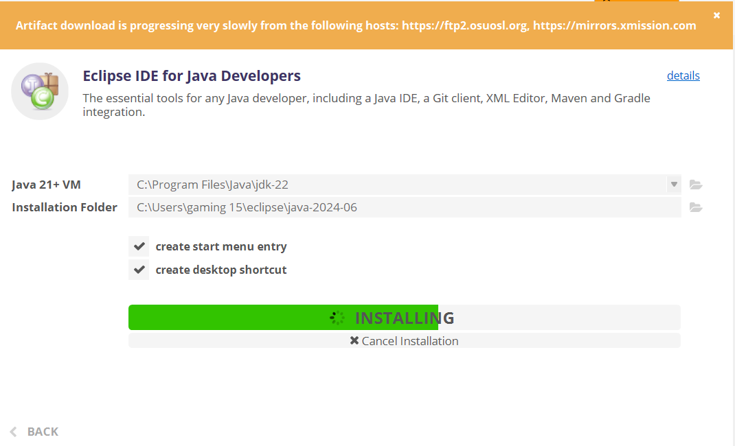
If you choose Eclipse IDE (Java)
Install Eclipse Software https://www.eclipse.org/downloads/

Slide 95
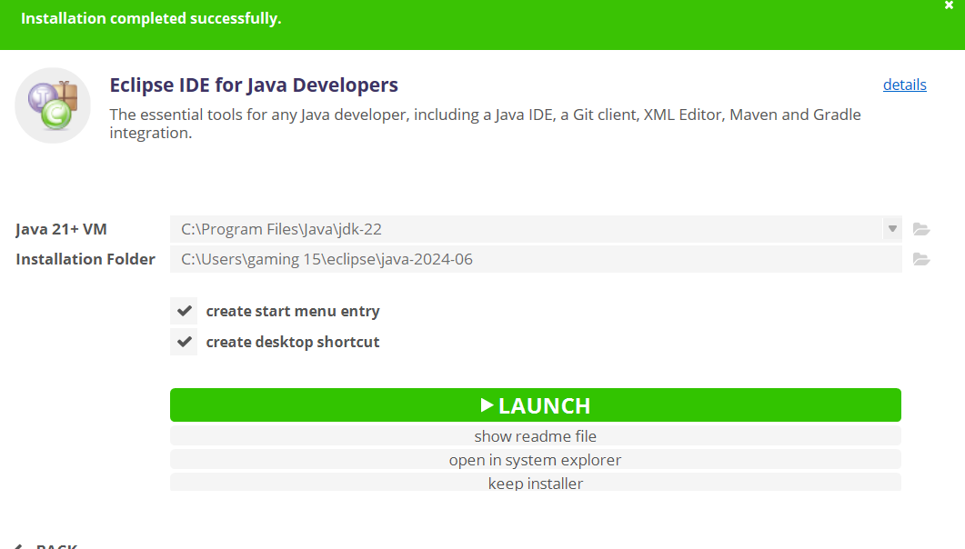
If you choose Eclipse IDE (Java)
Install Eclipse Software https://www.eclipse.org/downloads/

Slide 96
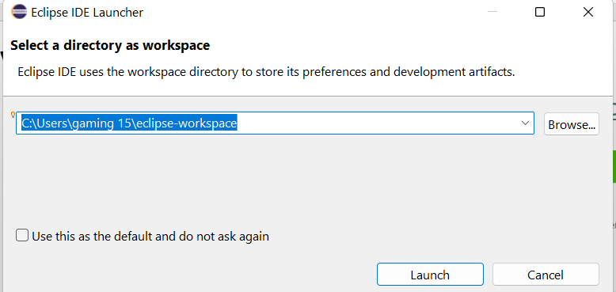
If you choose Eclipse IDE (Java)
Install Eclipse Software https://www.eclipse.org/downloads/

Slide 97
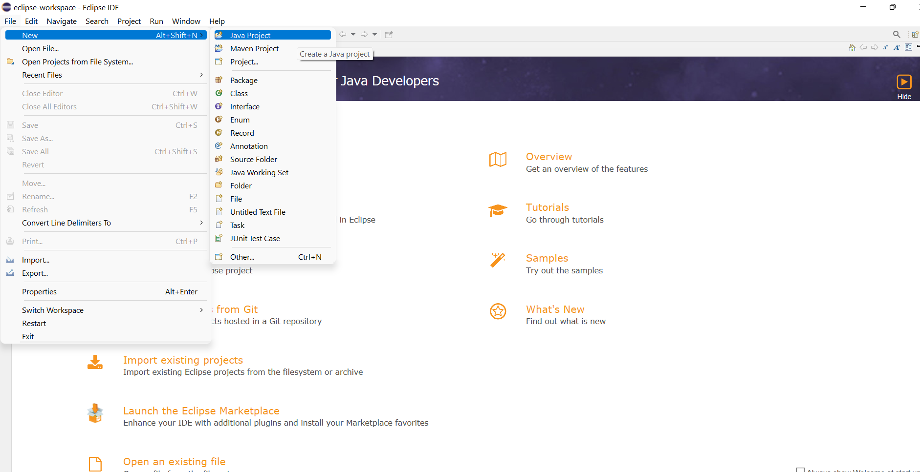
If you choose Eclipse IDE (Java)
Install Eclipse Software https://www.eclipse.org/downloads/

Slide 98
The First Java Program
We present a simple Java program (Listing 1.1) that prints "Welcome to Java!" to the console. We demonstrate the basic structure of a Java program, including the class definition and the main method, which is the entry point of any Java application.

Slide 99
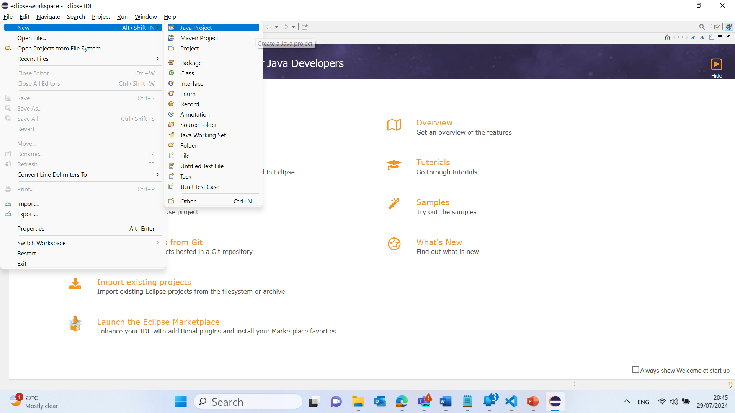
Simple User Input and Output Analysis in Java
1. Click on "Create a new Java project":
This will open a new window where you can set up your project.

Slide 100
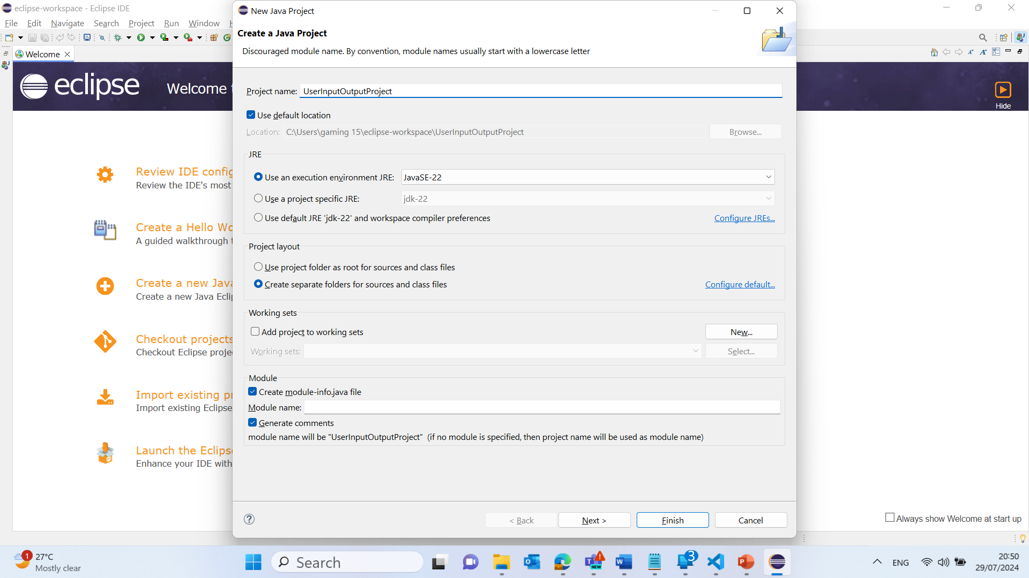
Simple User Input and Output Analysis in Java
2. Set up the new project:
Enter a project name (e.g., Welcome).
Click Finish.

Slide 101
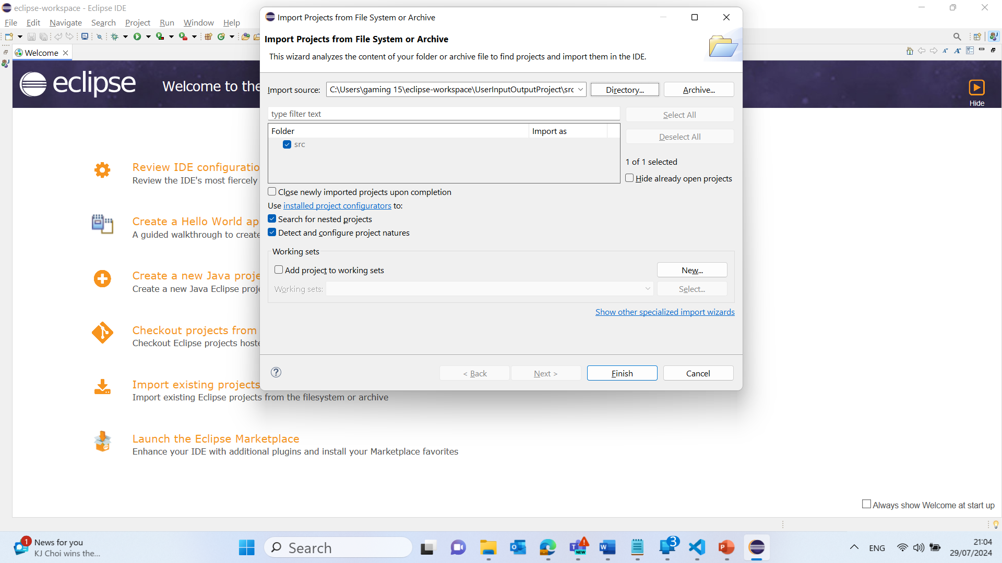
Simple User Input and Output Analysis in Java
2. Set up the new project:
Enter a project name (e.g., Welcome).
Click Finish.

Slide 102
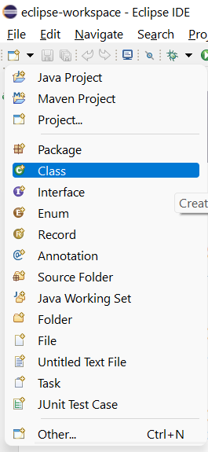
Simple User Input and Output Analysis in Java
3. Create a new Java class:
File >> Open Projects from File Systems >> Directory >> Choose the Direct where the Project is Saved ‘e.g. C:\Users\gaming 15\eclipse-workspace\Welcome\src’
Click on Select Folder
Select New > Class.

Slide 103
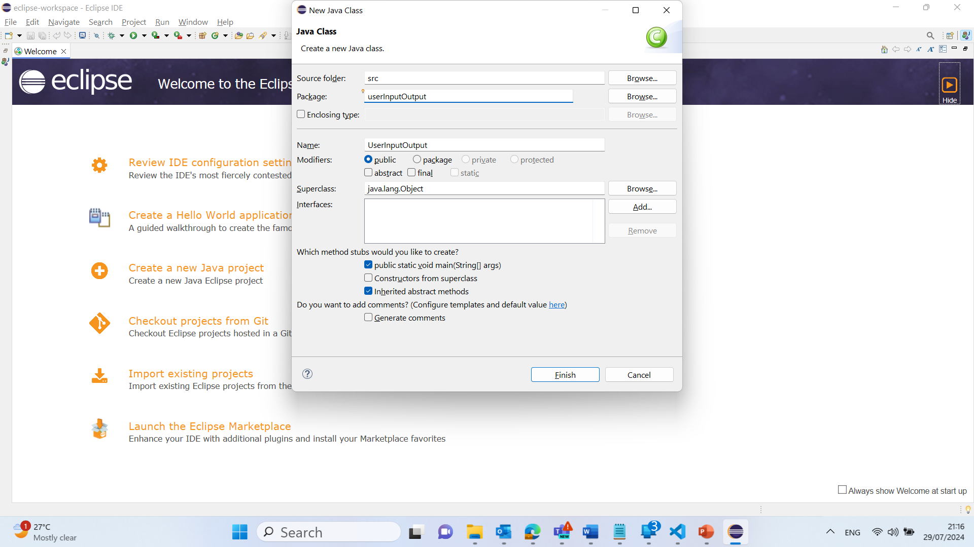
Simple User Input and Output Analysis in Java
Enter a class name (e.g., Welcome).
Ensure the public static void main(String[] args) option is checked.
Click Finish.
Click on Hide (Front Page)

Slide 104
Simple User Input and Output Analysis in Java
4. Write your Java code:
Copy and paste the code into the newly created class:

Slide 105
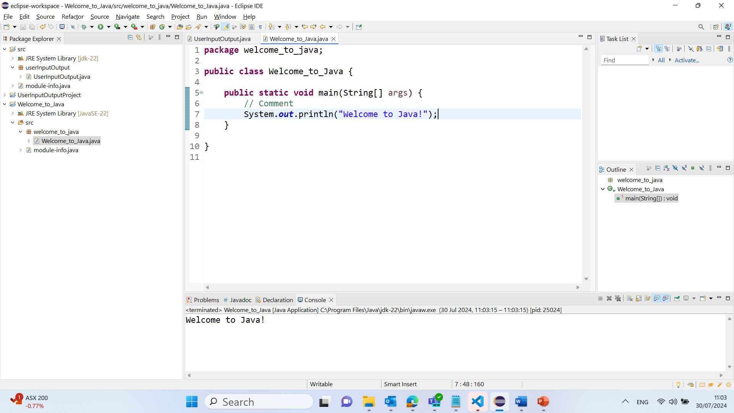
package welcome_to_java;
public class Welcome_to_Java {
public static void main(String[] args) {
// Comment
System.out.println("Welcome to Java!");
}
}
public class Welcome: Defines a public class named Welcome.
public static void main(String[] args): The main method is the entry point of the program.
System.out.println("Welcome to Java!");: Prints the message "Welcome to Java!" to the console.
This simple program introduces you to the fundamental components of a Java program, such as classes, methods, and the standard output function. By running this program, you get a practical understanding of how Java code is structured and executed.

Slide 106
Simple User Input and Output Analysis in Java
1. Click on "Create a new Java project":
This will open a new window where you can set up your project.

Slide 107
Simple User Input and Output Analysis in Java
2. Set up the new project:
Enter a project name (e.g., UserInputOutputProject).
Click Finish.

Slide 108
Simple User Input and Output Analysis in Java
2. Set up the new project:
Enter a project name (e.g., UserInputOutputProject).
Click Finish.

Slide 109
Simple User Input and Output Analysis in Java
3. Create a new Java class:
File >> Open Projects from File Systems >> Directory >> Choose the Direct where the Project is Saved ‘e.g. C:\Users\gaming 15\eclipse-workspace\UserInputOutputProject\src’
Click on Select Folder
Select New > Class.

Slide 110
Simple User Input and Output Analysis in Java
Enter a class name (e.g., UserInputOutput).
Ensure the public static void main(String[] args) option is checked.
Click Finish.
Click on Hide (Front Page)

Slide 111
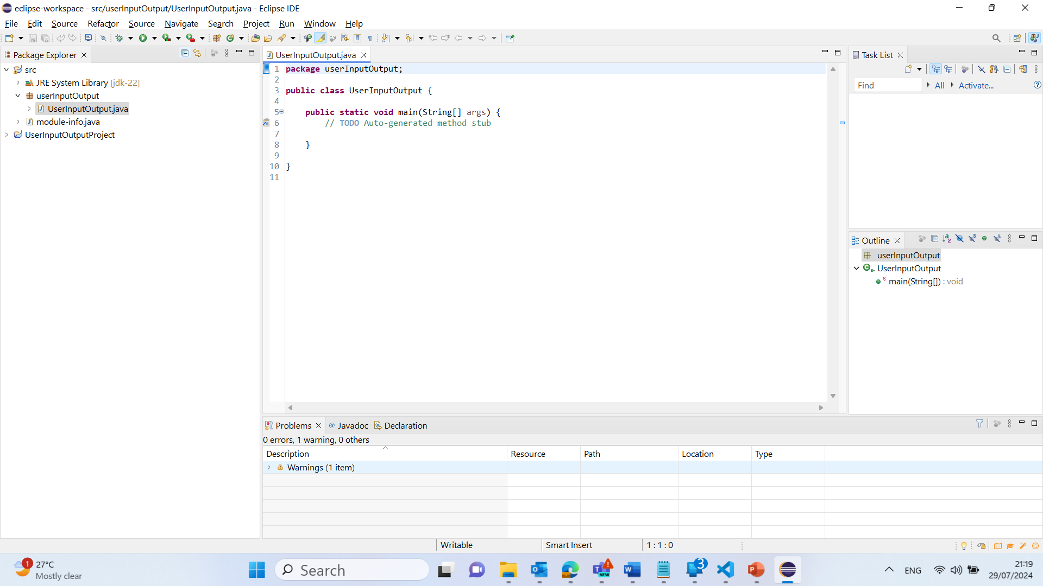
Simple User Input and Output Analysis in Java
4. Write your Java code:
Copy and paste the code into the newly created class:

Slide 112
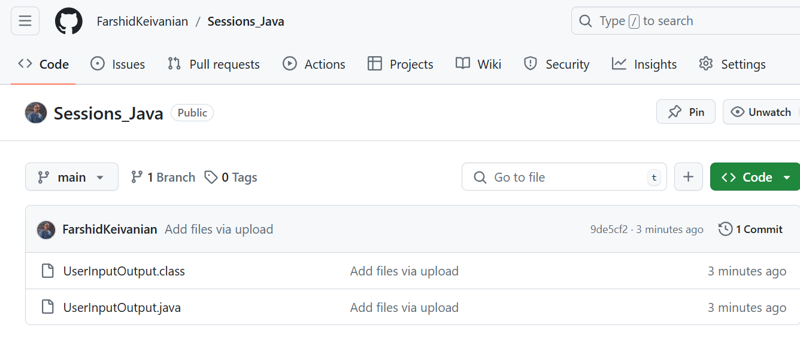
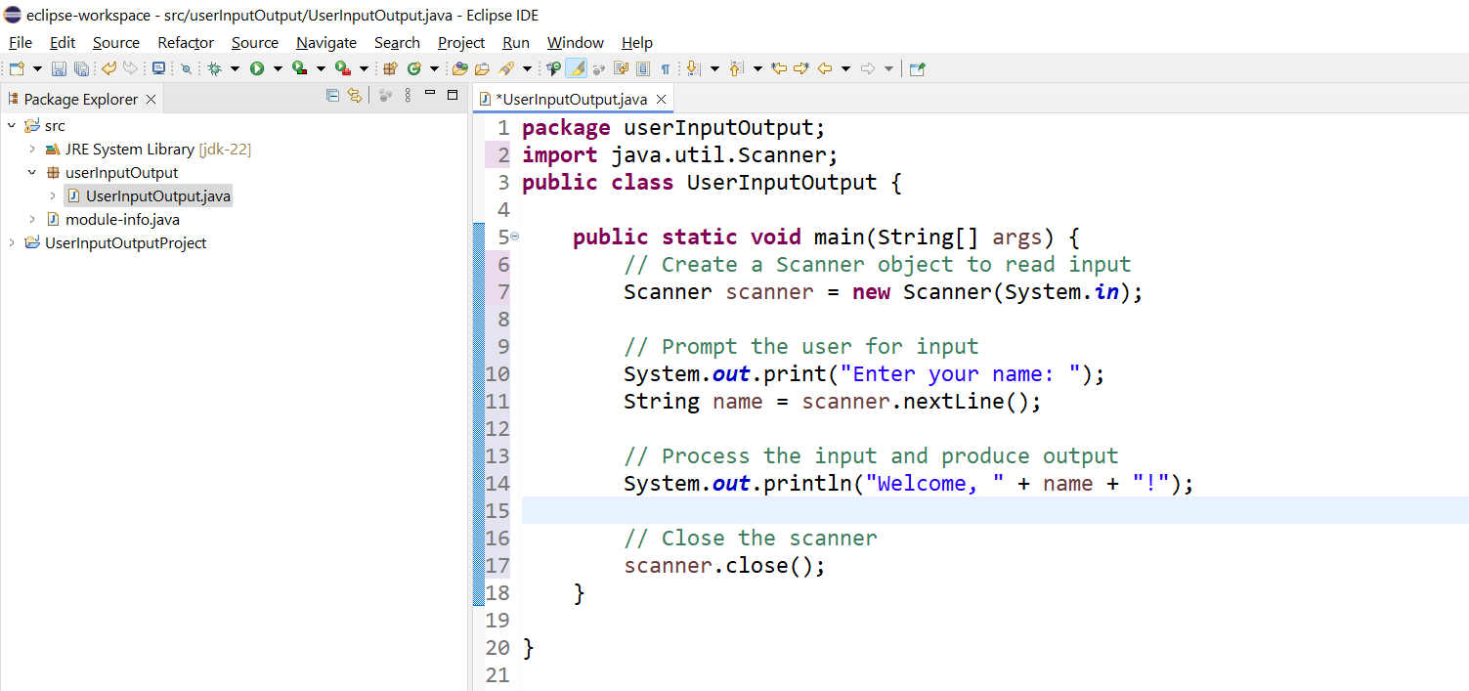
package userInputOutput;
import java.util.Scanner;
public class UserInputOutput {
public static void main(String[] args) {
// Create a Scanner object to read input
Scanner scanner = new Scanner(System.in);
// Prompt the user for input
System.out.print("Enter your name: ");
String name = scanner.nextLine();
// Process the input and produce output
System.out.println("Welcome, " + name + "!");
// Close the scanner
scanner.close();
}
}

Slide 113
package userInputOutput;
import java.util.Scanner;
public class UserInputOutput {
public static void main(String[] args) {
// Create a Scanner object to read input
Scanner scanner = new Scanner(System.in);
// Prompt the user for input
System.out.print("Enter your name: ");
String name = scanner.nextLine();
// Process the input and produce output
System.out.println("Welcome, " + name + "!");
// Close the scanner
scanner.close();
}
}
1. Import Statement:
import java.util.Scanner;
This line imports the Scanner class, which is used for reading input from the user.

Slide 114
package userInputOutput;
import java.util.Scanner;
public class UserInputOutput {
public static void main(String[] args) {
// Create a Scanner object to read input
Scanner scanner = new Scanner(System.in);
// Prompt the user for input
System.out.print("Enter your name: ");
String name = scanner.nextLine();
// Process the input and produce output
System.out.println("Welcome, " + name + "!");
// Close the scanner
scanner.close();
}
}
2. Class Declaration:
public class UserInputOutput {
This line declares a public class named UserInputOutput

Slide 115
package userInputOutput;
import java.util.Scanner;
public class UserInputOutput {
public static void main(String[] args) {
// Create a Scanner object to read input
Scanner scanner = new Scanner(System.in);
// Prompt the user for input
System.out.print("Enter your name: ");
String name = scanner.nextLine();
// Process the input and produce output
System.out.println("Welcome, " + name + "!");
// Close the scanner
scanner.close();
}
}
3. Main Method:
public static void main(String[] args) {
This is the entry point of the program where execution begins.

Slide 116
package userInputOutput;
import java.util.Scanner;
public class UserInputOutput {
public static void main(String[] args) {
// Create a Scanner object to read input
Scanner scanner = new Scanner(System.in);
// Prompt the user for input
System.out.print("Enter your name: ");
String name = scanner.nextLine();
// Process the input and produce output
System.out.println("Welcome, " + name + "!");
// Close the scanner
scanner.close();
}
}
4. Scanner Object Creation:
Scanner scanner = new Scanner(System.in);
This line creates a Scanner object to read input from the standard input stream (keyboard).

Slide 117
package userInputOutput;
import java.util.Scanner;
public class UserInputOutput {
public static void main(String[] args) {
// Create a Scanner object to read input
Scanner scanner = new Scanner(System.in);
// Prompt the user for input
System.out.print("Enter your name: ");
String name = scanner.nextLine();
// Process the input and produce output
System.out.println("Welcome, " + name + "!");
// Close the scanner
scanner.close();
}
}
5. Prompting for Input:
System.out.print("Enter your name: ");
This line prompts the user to enter their name.
6. Reading Input:
String name = scanner.nextLine();
This line reads the user's input and stores it in a variable named name.

Slide 118
package userInputOutput;
import java.util.Scanner;
public class UserInputOutput {
public static void main(String[] args) {
// Create a Scanner object to read input
Scanner scanner = new Scanner(System.in);
// Prompt the user for input
System.out.print("Enter your name: ");
String name = scanner.nextLine();
// Process the input and produce output
System.out.println("Welcome, " + name + "!");
// Close the scanner
scanner.close();
}
}
7. Producing Output:
System.out.println("Welcome, " + name + "!");
This line outputs a welcome message that includes the user's name.
8. Closing the Scanner:
scanner.close();
This line closes the Scanner object to free up resources.

Slide 119
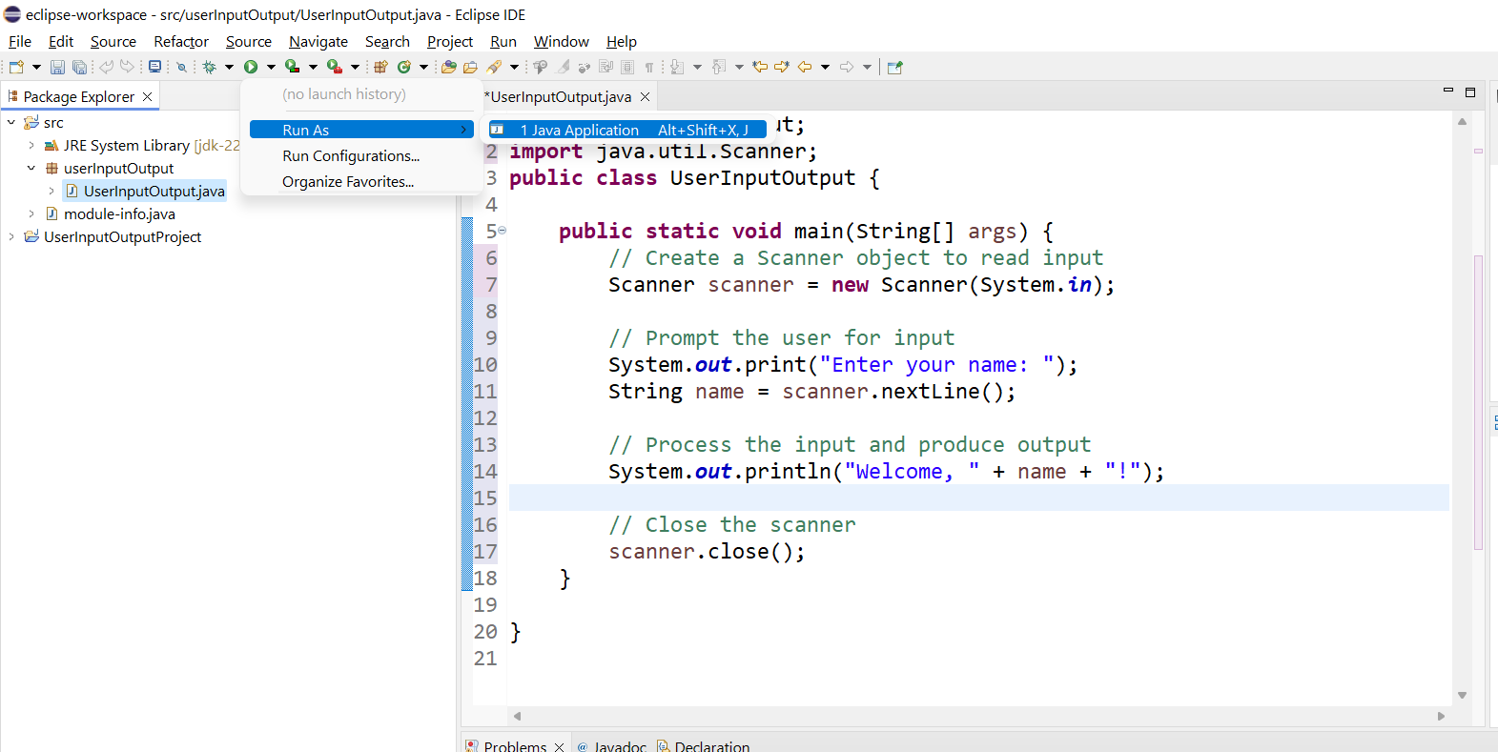
5. Run your Java program:
Right-click on your Java file (e.g., UserInputOutput.java).
Select Run As > Java Application.
This will execute your Java program, allowing you to enter your name and see the welcome message displayed in the console.

Slide 120
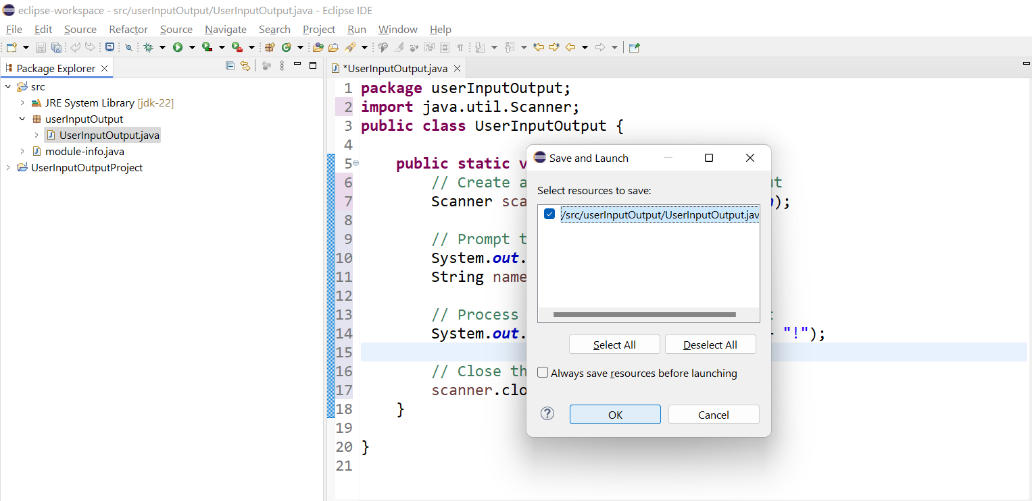
Select and Click on OK

Slide 121
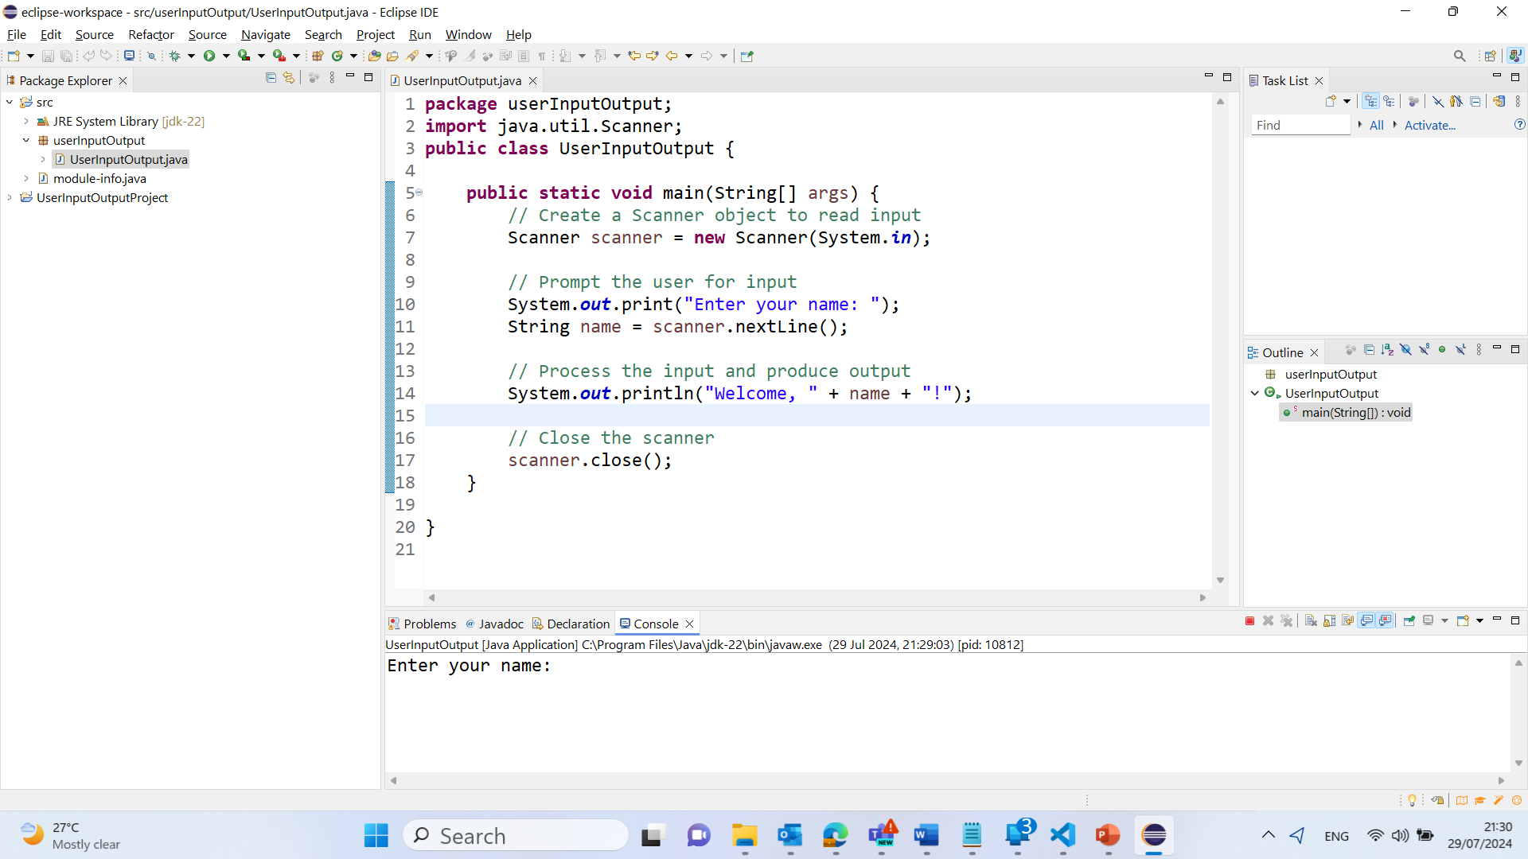
Output

Slide 122
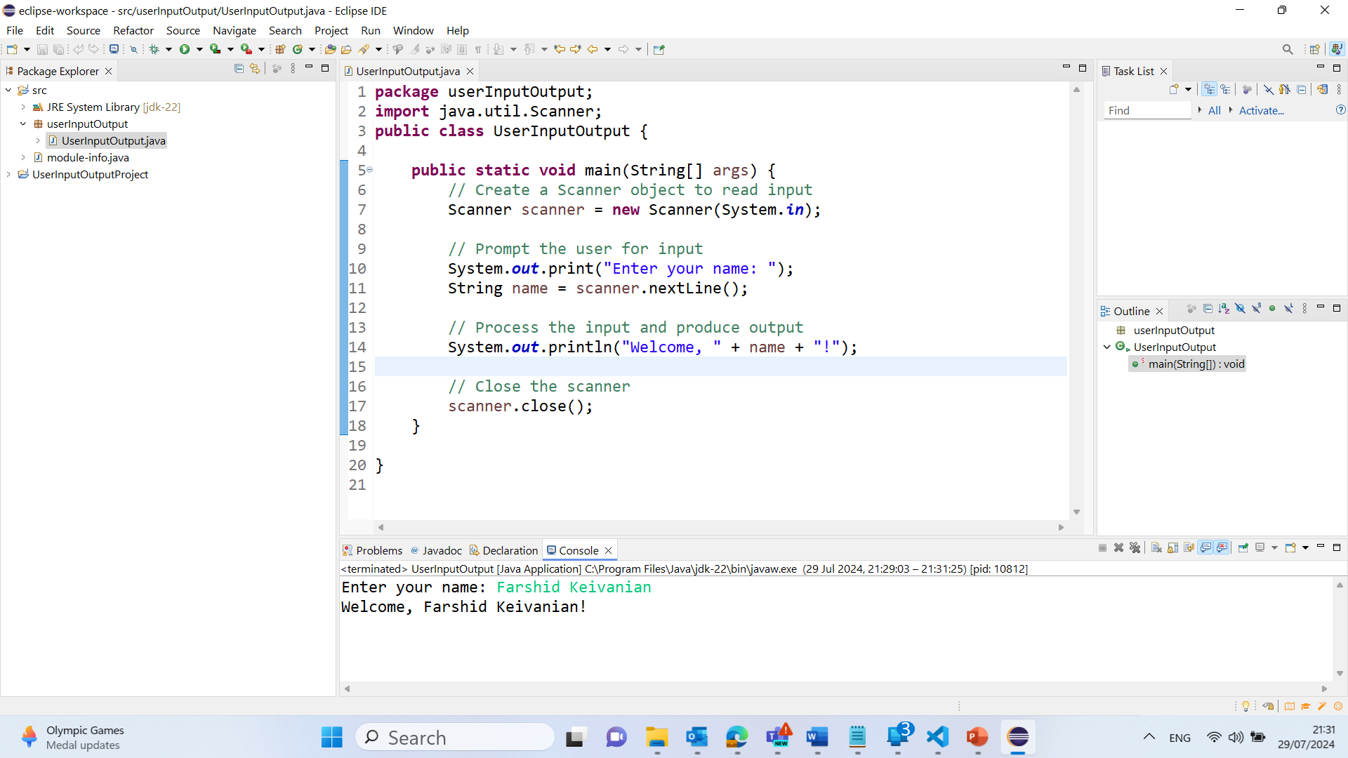
Output

Slide 123
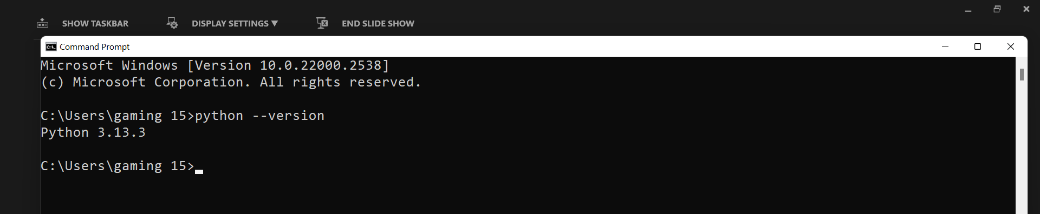
If you choose VS Code (Python)
Step 1: Install Python
For Windows 11:
Go to the official site: https://www.python.org/downloads/
Download the latest Python 3.x Windows Installer.
Important: During installation, check the box that says Add Python 3.x to PATH before clicking Install Now.
After installation, open Command Prompt (cmd) and type: python --version
You should see the Python version printed. This confirms it's correctly installed and added to PATH.

Slide 124
If you choose VS Code (Python)
For macOS:
Download the macOS installer from https://www.python.org/downloads/mac-osx/
Follow the installer instructions.
To verify, open Terminal and run:
python3 --version
(On Mac, we often use python3 instead of python.)
To update:
python -m pip install --upgrade pip

Slide 125
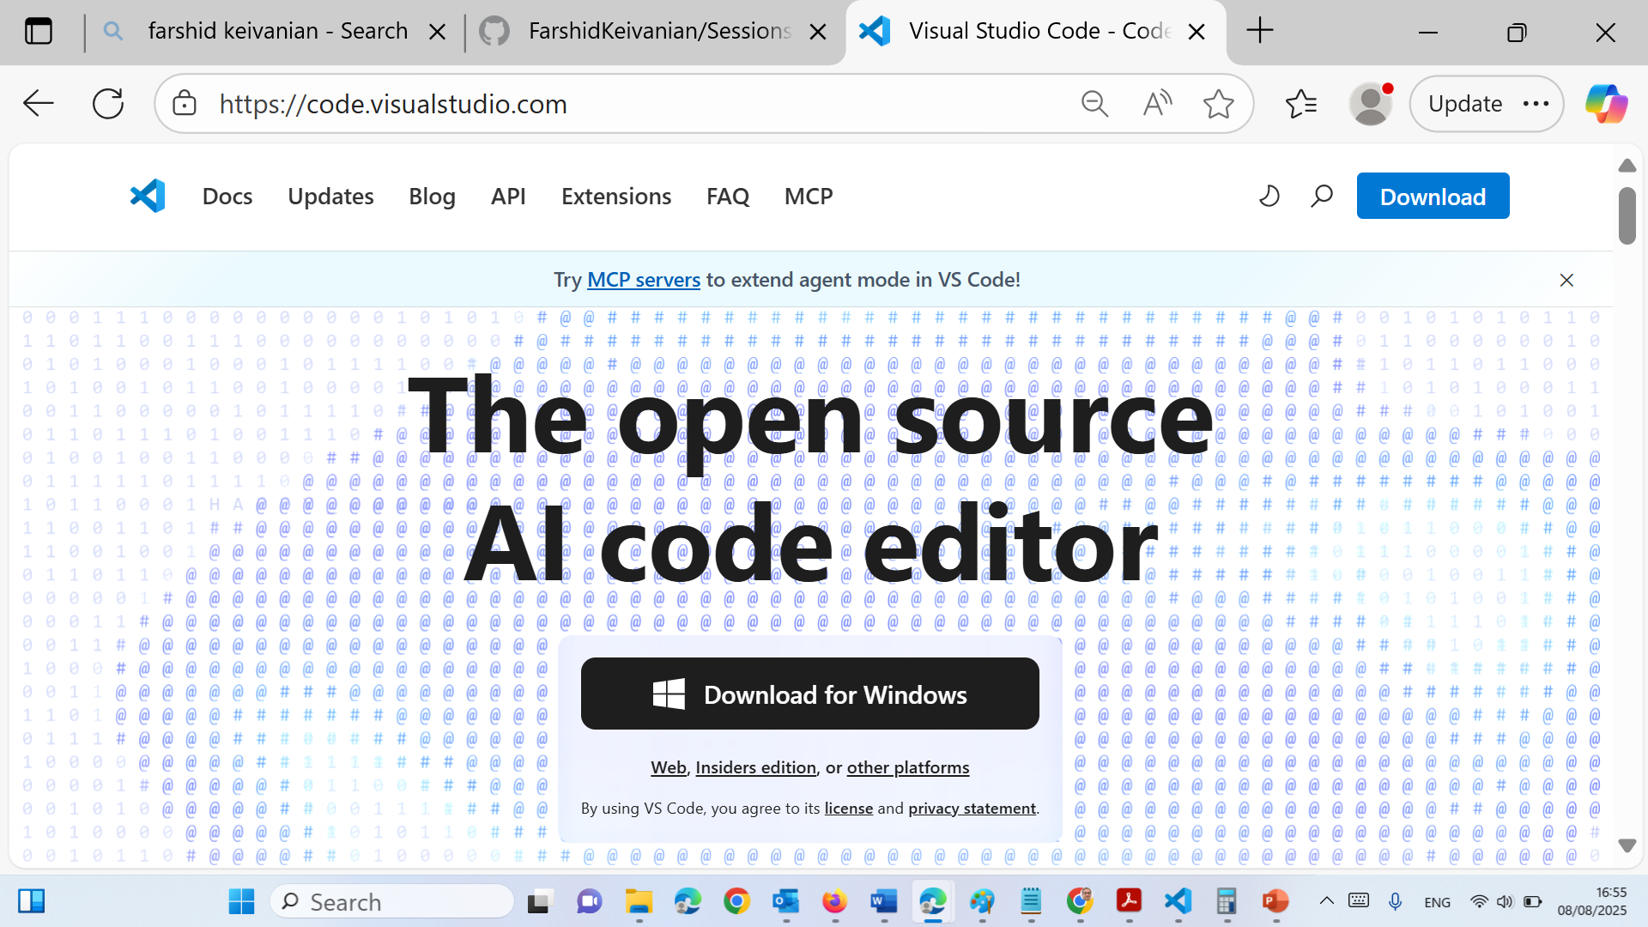
If you choose VS Code (Python)
Step 2: Install VS Code
Download VS Code: https://code.visualstudio.com/
Install it like any other application.
Open VS Code.

Slide 126
If you choose VS Code (Python)
Search and Install:
Search: Python
Install the Python extension by Microsoft (most important!).
(Optional but helpful) Install:
Jupyter (for .ipynb interactive notebook support)
Pylance (for IntelliSense)
Code Runner (if students want simpler one-click run for .py files)

Slide 127
If you choose VS Code (Python)
Step 4: Enable the Run Button (play) with Interactive Window
Open a .py file or create a new file and save it as yourfile.py.
After the Python extension is installed, VS Code will show a play Run button in the top right.
Click the dropdown arrow next to the play and choose:
"Run Current File in Interactive Window".
If you are using a .ipynb (Jupyter Notebook) file, it will automatically show “Run Cell” and work interactively once the Jupyter extension is installed.

Slide 128
If you choose VS Code (Python)
Step 5: Select Python Interpreter (If Not Detected)
Press Ctrl+Shift+P (or Cmd+Shift+P on Mac) to open the command palette.
Type: Python: Select Interpreter
Choose the one that shows your installed Python path (e.g., Python 3.x with correct version).

Slide 129
If you choose VS Code (Python)
Troubleshooting Common Issues
Run Button Not Appearing?
Make sure:
Python extension is installed.
File is saved with .py or .ipynb extension.
Python interpreter is selected in bottom-left/status bar.
Getting “Python not found”?
On Windows, make sure Add to PATH was checked during installation.
On macOS, use python3 instead of python.

Slide 130
If you choose VS Code (Python)
Summary Checklist
Step | Task | Windows | Mac
1 | Install Python | [ Add to PATH] | [Use python3]
2 | Install VS Code
3 | Install Extensions | Python, Jupyter | Same
4 | Configure Interpreter | Ctrl+Shift+P → Select Python | Same
5 | Run Code | Play → Interactive Window | Play works the same

Slide 131
If you choose VS Code (Python)
Sometimes, students may see an error like:
"Cannot run cells, ipykernel is not installed." or "Kernel 'Python 3' cannot be started using the selected interpreter."
This happens if:
They installed Python but haven't installed any packages (especially in a new/clean environment).
They’re using a virtual environment that doesn’t have ipykernel.

Slide 132
If you choose VS Code (Python)
To fix it (if needed), they can run:
On Windows (Command Prompt):
pip install ipykernel

Slide 133
If you choose VS Code (Python)
On macOS (Terminal):
pip3 install ipykernel

Slide 134
If you choose VS Code (Python)
Or from inside VS Code's terminal (Ctrl + ~), run:
python -m pip install ipykernel

Slide 135
How to Succeed in the Unit
Pro Tips:
Pick one language (Java or Python) and stick with it
Use UML tools to map your ideas before coding
Use Git for version control from the start
Reach out if you’re stuck — don’t wait until it’s too late!

Slide 136
UML Diagrams
Draw.io is Suitable:
Free and browser-based — no installation needed
Supports all standard UML diagram types: use case, activity, class, sequence, etc.
Can save files to local storage or Google Drive
Easy to export as .png, .pdf, or .drawio files for submission

Slide 137
UML Diagrams
UML Tool Recommendation: You can use Draw.io (diagrams.net) to create UML diagrams like Use Case, Activity, or Class Diagrams. Export your diagrams as .png or .drawio and upload with your lab submission.

Slide 138
Recommended Software Configuration Management (SCM): Git & Git Bash
Why Use Git?
Git is a fast, distributed version control system ideal for tracking code changes and collaborating with others.
It's widely used in industry (e.g., GitHub, GitLab, Bitbucket).

Slide 139
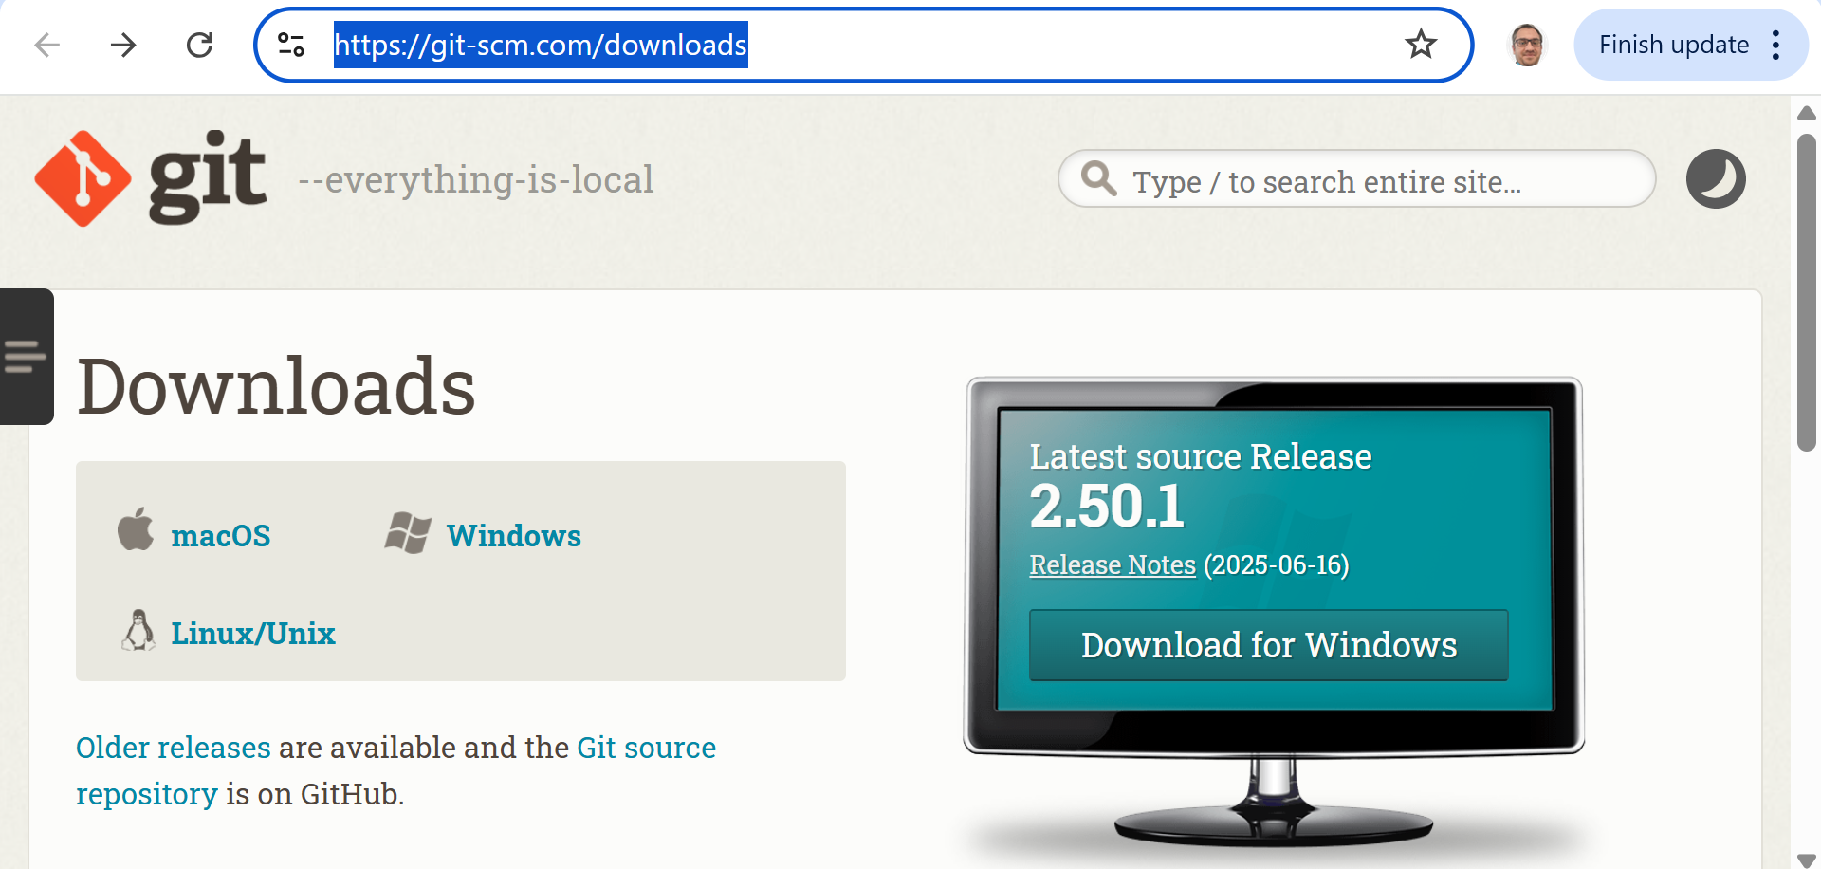
Recommended Software Configuration Management (SCM): Git & Git Bash
Recommended Tools:
Git Bash (Windows): A command-line interface that provides Unix-style commands to use Git on Windows easily.
Git for Windows (latest: v2.50.1, released 8 July 2025):
Downloads
Download Git for Windows (x64)
Install using terminal (if Winget is available):
winget install --id Git.Git -e --source winget

Slide 140
Modern Software Development Tools (2026–2028)
What do software developers use in industry?
Category | Common Tools
Programming Languages | Java, Python, JavaScript, TypeScript, C#, Go
IDEs | VS Code, IntelliJ IDEA, Eclipse, PyCharm, Visual Studio
Version Control | Git, GitHub, GitHub Desktop, GitLab
Project Management | Jira, Confluence, Azure DevOps, Trello
UML & Design | diagrams.net (Draw.io), Lucidchart
Databases | MySQL, PostgreSQL, SQL Server, MongoDB
Cloud Platforms | Microsoft Azure, AWS, Google Cloud
Containers | Docker
Testing | JUnit, PyTest, Selenium
CI/CD | GitHub Actions, Azure DevOps, Jenkins
Communication | Microsoft Teams, Slack

Slide 141
Modern Software Development Tools (2026–2028)
AI Tools Used by Software Developers (2026–2028)
Artificial Intelligence is becoming a standard part of software development.
Developers commonly use AI to:
Generate code
Explain code
Debug programs
Write documentation
Create unit tests
Improve code quality
Learn new programming concepts

Slide 142
Modern Software Development Tools (2026–2028)
Popular AI Tools
AI Tool | Common Use
GitHub Copilot | AI coding assistant inside the IDE
ChatGPT | Code explanations, debugging, learning, documentation
Microsoft Copilot | Programming, Microsoft 365, Azure development
Gemini | Programming assistance and code explanation
Claude | Software design, documentation, code review
Amazon Q Developer | AWS development and cloud programming
Cursor AI | AI-powered code editor
JetBrains AI Assistant | AI integrated into IntelliJ IDEA

Slide 143
Modern Software Development Tools (2026–2028)
AI does not replace software developers.
Developers still need to:
Understand the problem
Design the solution
Verify AI-generated code
Test the software
Ensure security and privacy
Communicate with users and team members
Your understanding is more important than AI-generated code.

Slide 144
Skills Employers Look For (2026–2028)
Technical Skills
Programming (Java, Python)
Object-Oriented Programming (OOP)
SQL and Databases
Git and GitHub
Cloud Computing (Azure or AWS)
Software Testing
APIs
Problem Solving
AI-assisted Software Development

Slide 145
Skills Employers Look For (2026–2028)
Professional Skills
Communication
Teamwork
Time Management
Critical Thinking
Continuous Learning
Ethical and Responsible AI Use

Slide 146
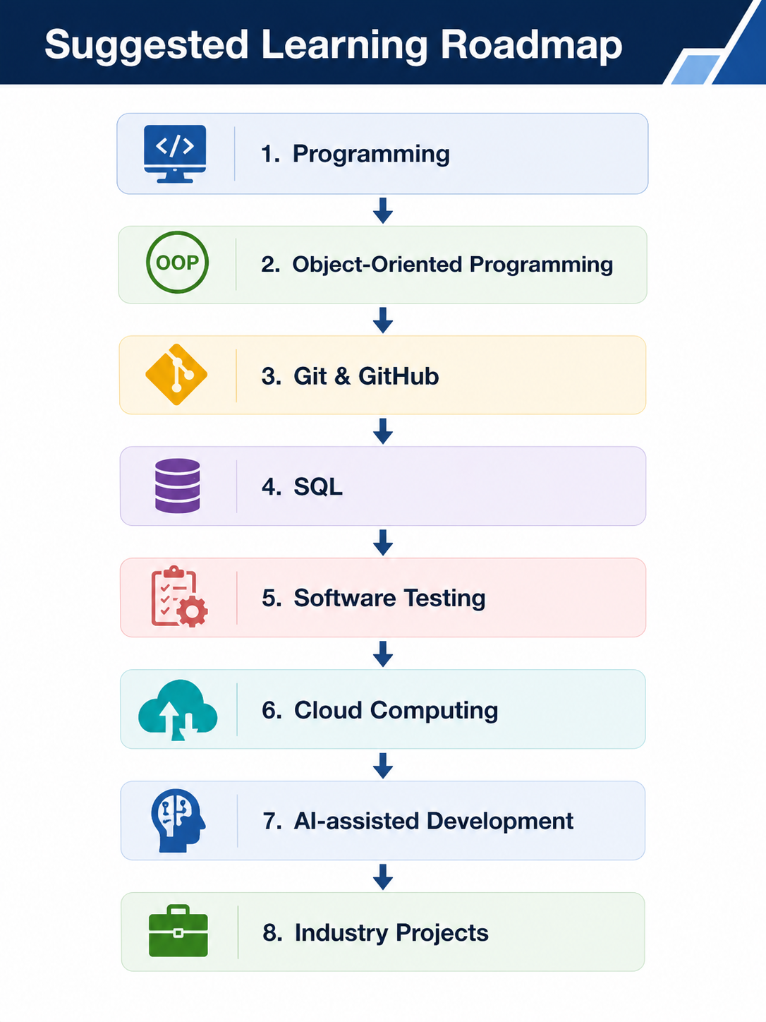
Suggested Learning Roadmap
Don't try to learn everything at once.
Instead, become confident in:
Java or Python
GitHub
Object-Oriented Programming
UML
SQL
Then gradually build additional skills in:
Cloud Computing
Artificial Intelligence
DevOps
Cybersecurity

Slide 147
Suggested Learning Roadmap
Companies are not looking for developers who can memorise syntax. They are looking for developers who can analyse problems, design solutions, collaborate with others, use modern tools—including AI—responsibly, and continue learning throughout their careers.

Slide 148
Week 1 Summary and Key Takeaways
This Week You Learned
Software Development Fundamentals
What software development is
The Software Development Life Cycle (SDLC)
Waterfall and Agile methodologies
Software Modelling
Introduction to UML (Unified Modeling Language)
Requirements analysis
Use cases and actors

Slide 149
Week 1 Summary and Key Takeaways
Programming Concepts
Introduction to Object-Oriented Programming (OOP)
Difference between CLI and GUI applications
Java and Python development environments
Development Tools
Canvas
GitHub and GitHub Desktop
VS Code, IntelliJ IDEA, Eclipse, or PyCharm
diagrams.net (Draw.io)

Slide 150
Week 1 Summary and Key Takeaways
Assessments
Assessment 1 (Case Study) – 70%
Quiz 1 – 15%
Quiz 2 – 15%

Slide 151
Week 1 Summary and Key Takeaways
Remember
Programming is learned by practising, not just reading.
Make mistakes—they are part of learning.
Ask questions during tutorials.
Start assessments early.
Work consistently each week rather than leaving everything until the deadline.

Slide 152
Lab 1 Exercises
Complete the Lab 1 Exercises exercises as a team
(form groups of 3-4 students, one student acts as the client)

Slide 153
Lab 1 Exercises
Lab Tools:
The following tools are recommended to complete Lab 1 Exercises activities:
Download and use Visual Paradigm Community Edition
Use the online drawing tool: draw.io
Feel free to use other tools of choice!

Slide 154
Lab 1 Exercises
Lab Case Study: The bank system
Your team is hired to develop a desktop banking application for local bank. The bank manager has general IT knowledge but does not know programming too well.
The bank currently operates a web-based application. The objective is to have an in-branch desktop application that includes two types of banking interactions: CLI and GUI.
Both interfaces should be accessible using the branch computers where the application is installed. After consultation with the bank manager, the decision was to name the new application: DeskBankApp.
DeskBankApp enables registered bank customers and bank employees (Manager) to access the system.
DeskBankApp computers are mounted on top of small ATMs to allow customers make deposits or withdraws.

Slide 155
Lab 1 Exercises
Lab Case Study: The bank system – The manager’s requirements
The bank manager requires the following functionalities in DeskBankApp:
Customer can log in to the system (assume either GUI or CLI)
Manager can log in to the system (assume either GUI or CLI)
Customer can view their bank accounts
Customer can make a deposit
Customer can pay (an account or a credit card)
Customer can withdraw
Manager can view all customers
Manager can add/remove a customer

Slide 156
Lab 1 Exercises
Read and understand the requirements, discuss the requirements within your team.
Perform requirements validation with stakeholders (client, tutor – as the delivery manager). [check for: compliance, correctness, completeness, consistency]
Identify use cases.
Map use cases into a use case backlog.
Draw a use case diagram for the new DeskBankApp system.

Slide 157
Lab 1 Exercises
From Requirements to Use Case Diagram:
Gather and analyze requirements
Identify external actors
Define use cases based on user goals; focus on verbs
Draw system boundary
Connect actors to use cases
Identify relationships and denote them on the diagram

Slide 158
Lab 1 Exercises
Focus on the what not the how:
Some use cases can simply be mapped to functions
Some use cases are high-level and involve multiple steps or actions – and it also doesn’t mean that each step corresponds to a function, e.g., a Marketplace application relies on a 3rd party payment gateway integration through APIs.

Slide 159
Lab 1 Exercises
Question 1
What is the name of the new banking application?
The application is called DeskBankApp.
Question 2
Why is DeskBankApp being developed?
The bank already has a web-based system, but it also wants an in-branch desktop application for branch computers.

Slide 160
Lab 1 Exercises
Question 3
What two types of interfaces must DeskBankApp provide?
DeskBankApp must provide:
CLI — Command-Line Interface
GUI — Graphical User Interface

Slide 161
Lab 1 Exercises
Question 4
Who can use DeskBankApp?
There are two main users:
Customer
Manager
These users are called actors in a use-case diagram.

Slide 162
Lab 1 Exercises
Question 5
What can a customer do?
A customer can:
Log in
View bank accounts
Make a deposit
Make a payment
Withdraw money

Slide 163
Lab 1 Exercises
Question 6
What can a manager do?
A manager can:
Log in
View all customers
Add a customer
Remove a customer

Slide 164
Lab 1 Exercises
Question 7
What is requirements validation?
Requirements validation means checking whether the requirements are suitable before design and coding begin.
Check for:
Compliance — Do the requirements follow relevant rules?
Correctness — Do they describe what the bank actually needs?
Completeness — Is anything important missing?
Consistency — Do any requirements contradict each other?

Slide 165
Question 8
What questions should we ask the bank manager?
What information is required for customer login?
Can a customer have more than one account?
What types of accounts are supported?
Are there withdrawal limits?
Can a customer pay another bank account?
How is a credit-card payment processed?
Can a manager edit customer information?
What happens after several failed login attempts?
Should transactions be stored in a file or database?
Does the system need to print receipts?
These questions help make the requirements more complete.

Slide 166
Lab 1 Exercises
Question 9
What is an actor?
An actor is a person, device, or external system that interacts with the application.
For DeskBankApp:
Customer is an actor.
Manager is an actor.

Slide 167
Lab 1 Exercises
Question 10
What is a use case?
A use case describes a goal that an actor wants to achieve using the system.
Examples:
Log in
View accounts
Make deposit
Withdraw money
Add customer
Use cases are normally written using verbs because they describe actions.

Slide 168
Question 11) Why should we focus on “what” rather than “how”?
A use-case diagram shows what the system must do, not the programming details.
For example:
Make Payment
is a suitable use case.
The diagram does not need to show:
Python functions
Java methods
SQL queries
API code
Button-click code
Those details are considered later during design and development.

Slide 169
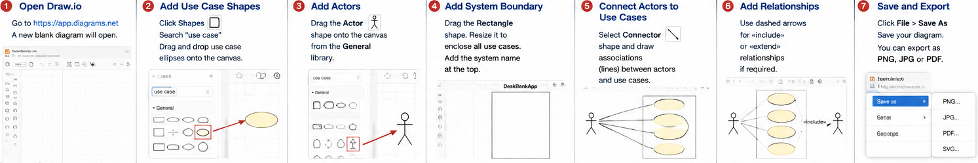
Lab 1 Exercises

Slide 170
Week 1 Summary and Key Takeaways
Every expert programmer was once a beginner. Focus on understanding the concepts, practise regularly, and don't be afraid to ask questions. Small improvements every week lead to big achievements by the end of the semester.

Slide 171

Let’s Answer Your Questions
Canvas Inbox – For academic queries.
Email – For formal communication and attachments.
Canvas Discussion – For academic discussions and general queries.
Reminder – Please follow up if you do not receive a response within 3 business days.

Slide 172

Happy Learning and Bright Futures Ahead! Dr. Farshid Keivanian Stay Connected: linkedin.com/in/farshid-keivanian github.com/FarshidKeivanian
Education is the most powerful weapon you can use to change the world. — Nelson Mandela

